Slide 1
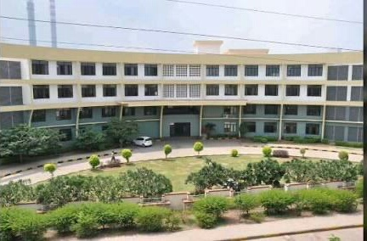
JINDAL ADARSH VIDYALAYA
PRE-PRIMARY VIRTUAL JOURNEY
Reflection of the year 2020-21
Topic: Go back to go forward
Grade : ukg

Slide 2
Glimpses of some insightful processes and practices
These practices are great learning experience for our students and they have enriched with a broader perspective of life.

Slide 3
Kindness

Slide 4
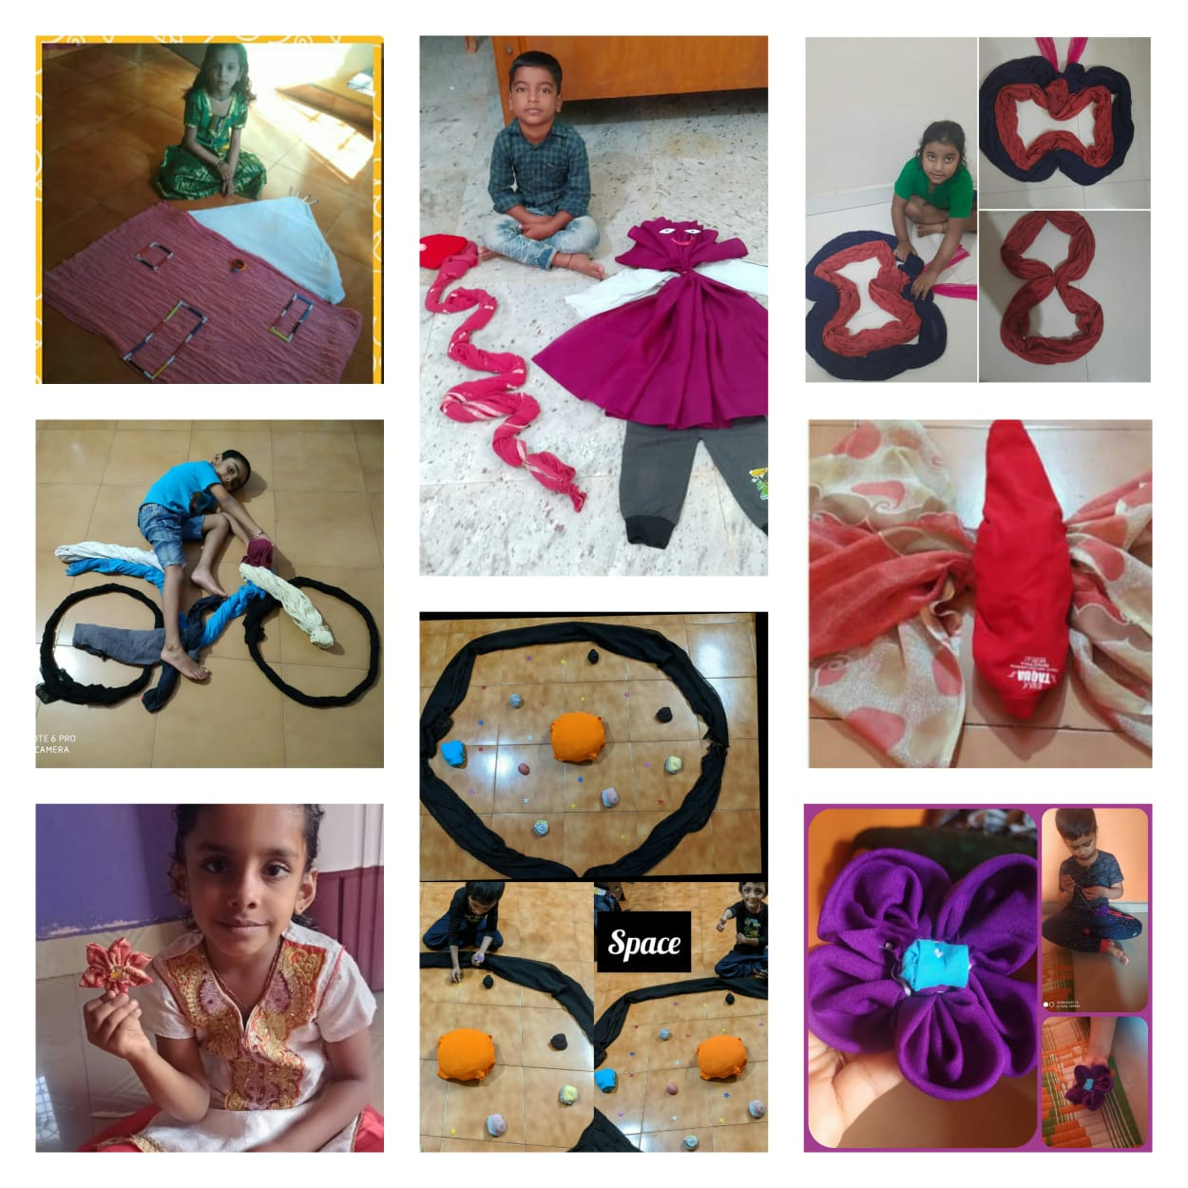
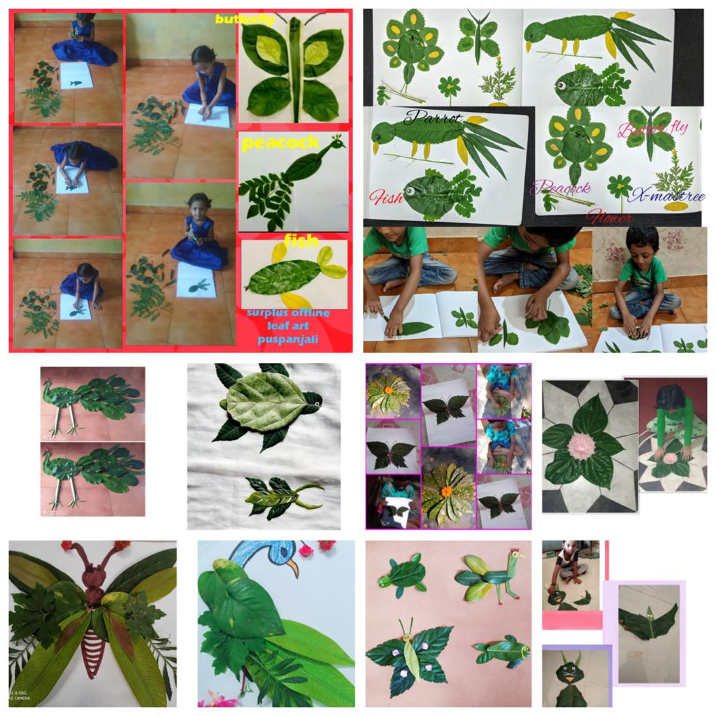
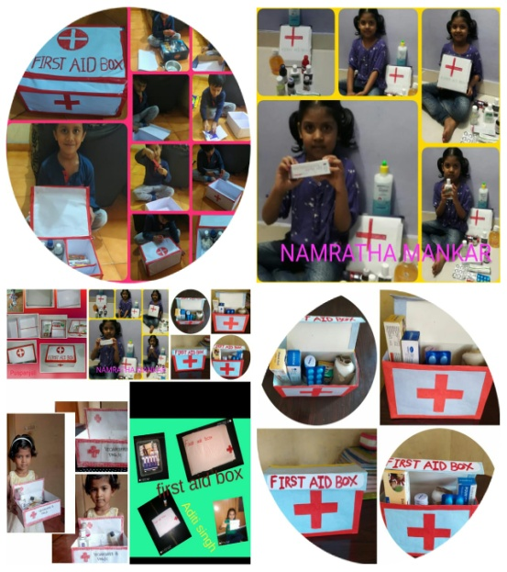
Surplus
Tent House
Fabric Design
Leaf Art
First Aid kit

Slide 5
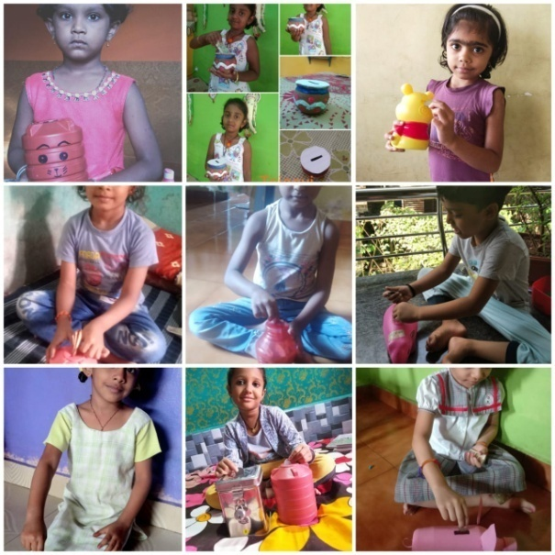
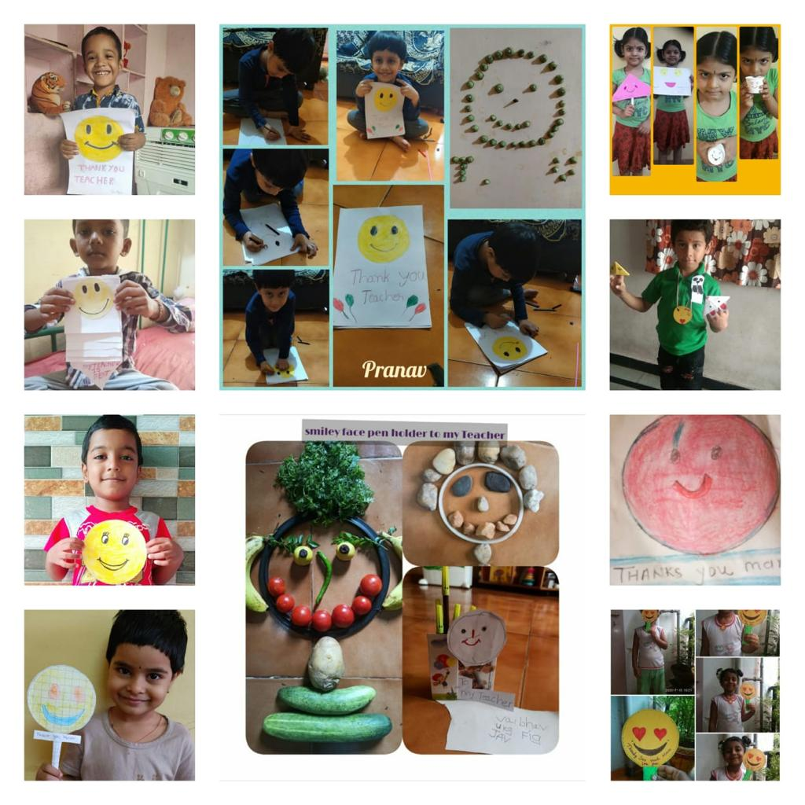
Gratitude
Magic Cards
Piggy bank

Slide 6
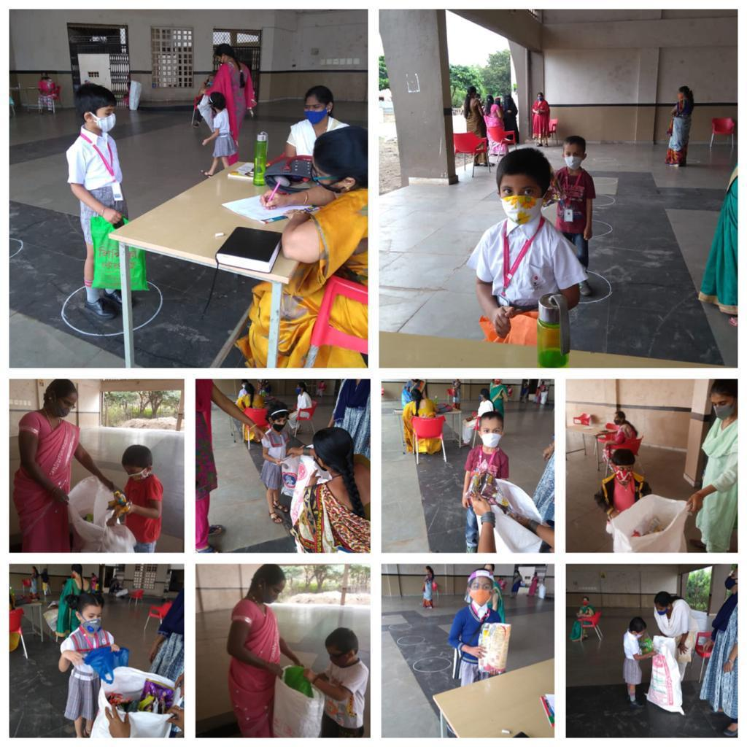
Citizenship
Collection of MLP Wrappers

Slide 7
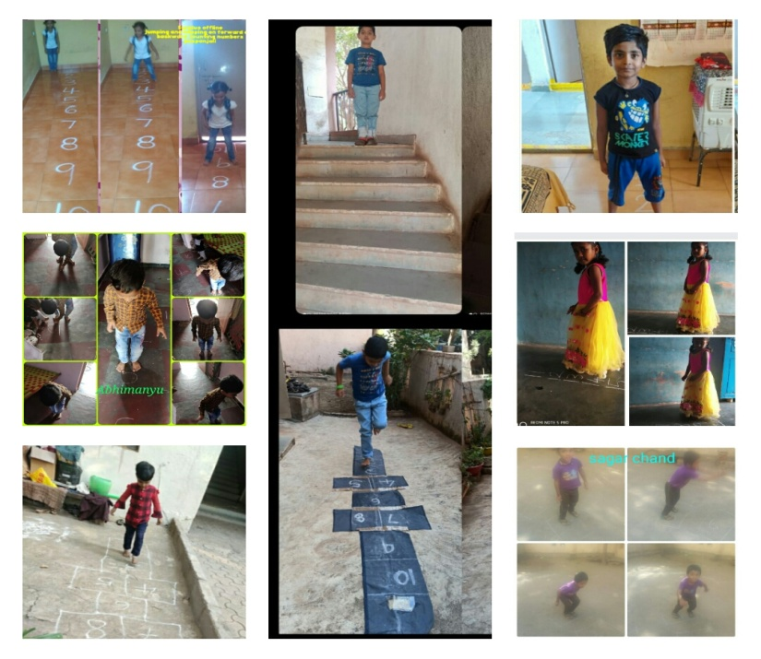
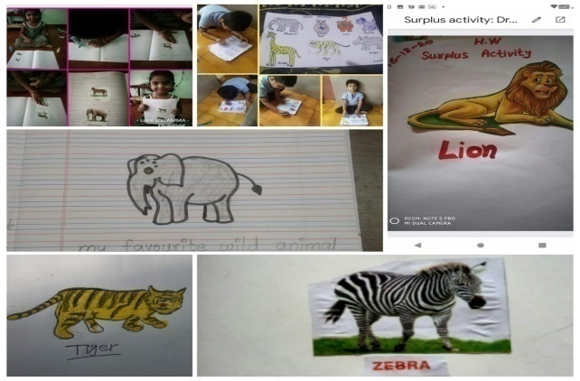
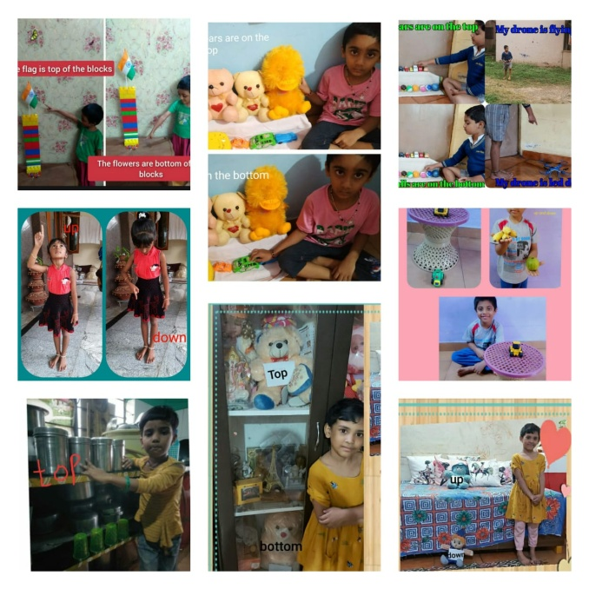
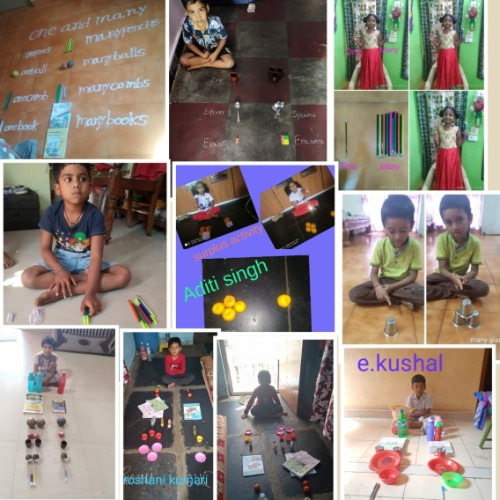
Academics
Concept Based Activities

Slide 8
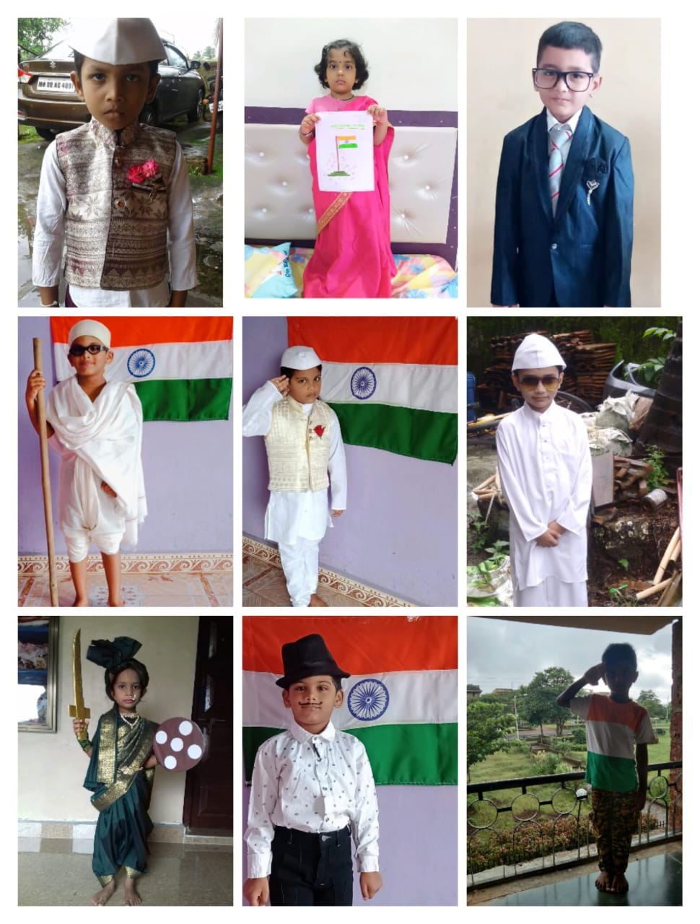
Celebrations – Colour days & Festivals
Independence Day
Grey Day

Slide 9
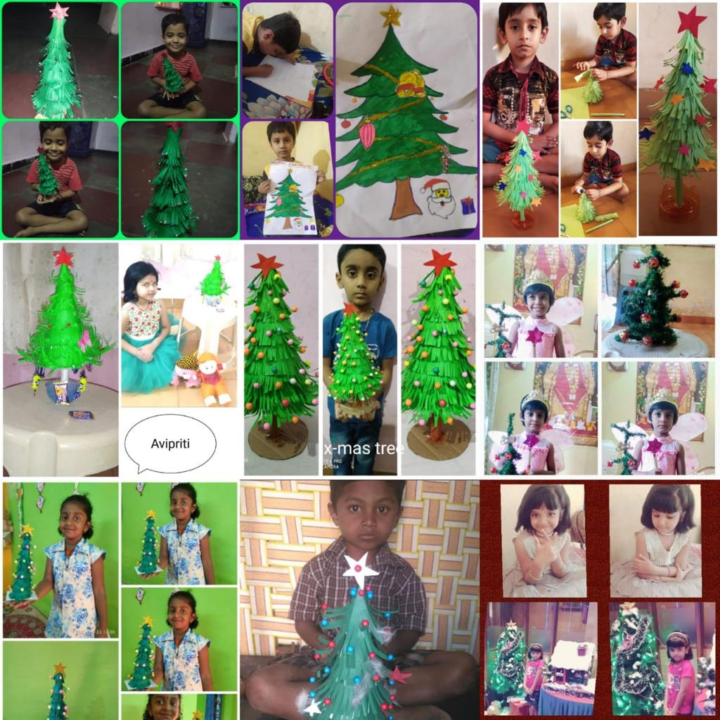
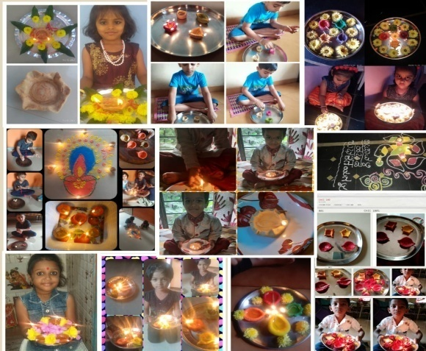
Celebrations – Colour days & Festivals
Christmas
Diwali

Slide 10
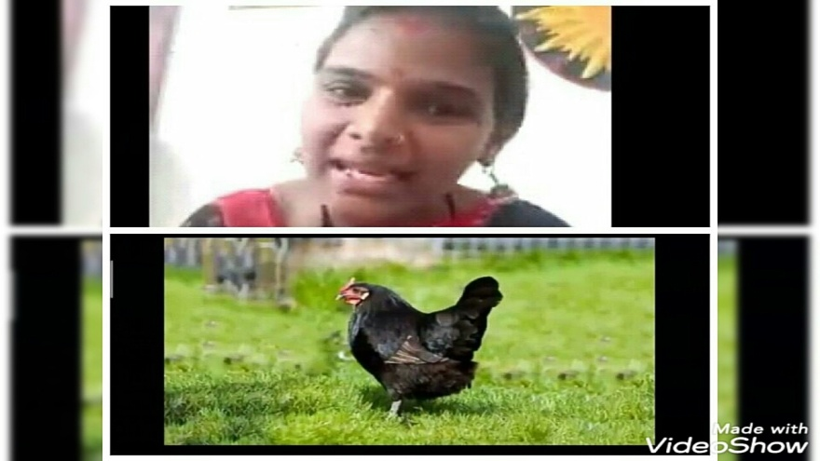
Mental Spa

Slide 11
Master Class

Slide 12
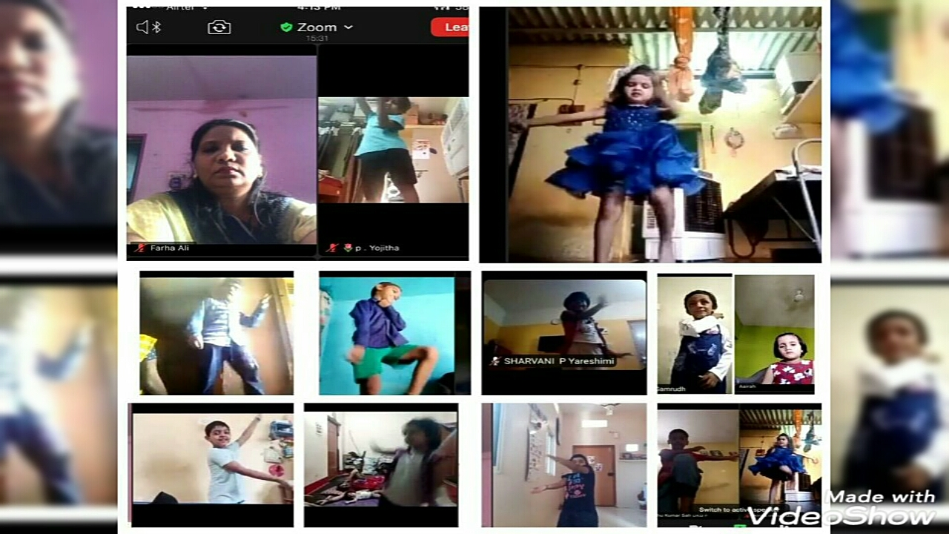
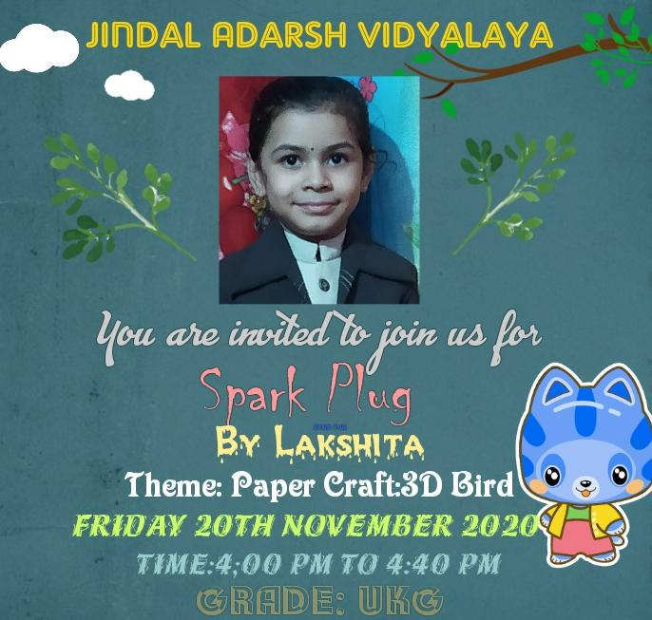
Spark Plug

Slide 13
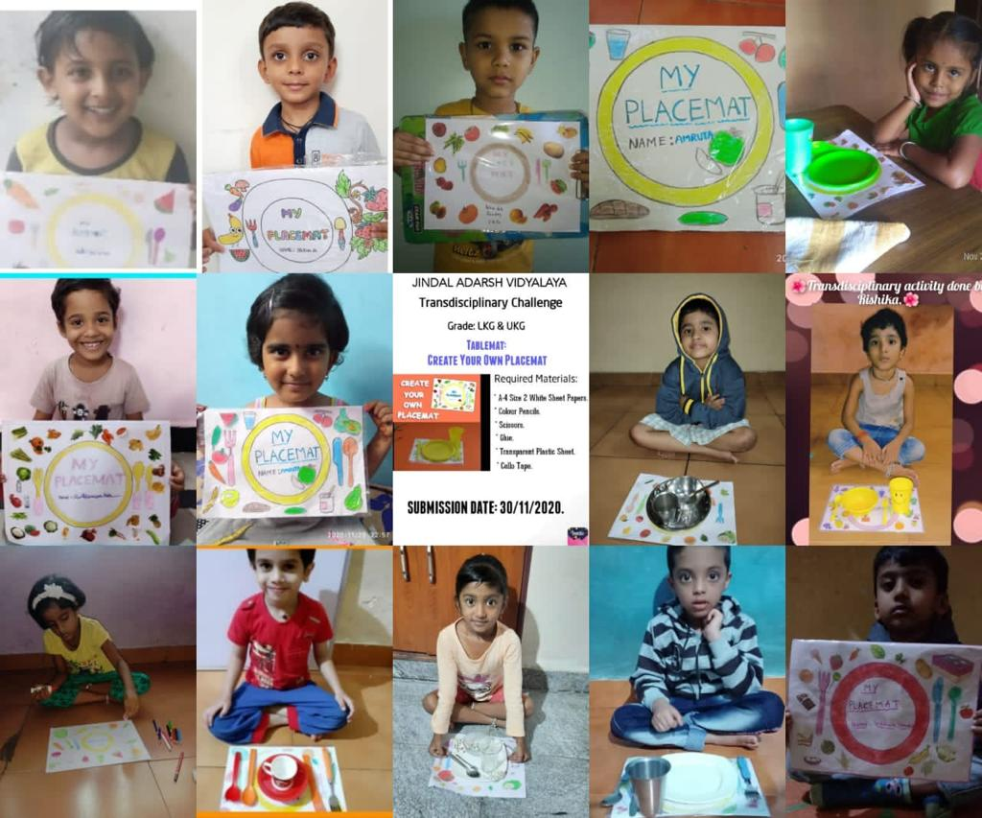
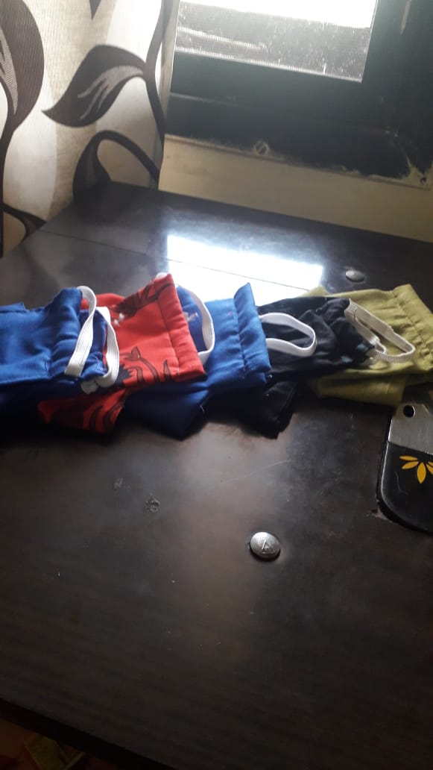
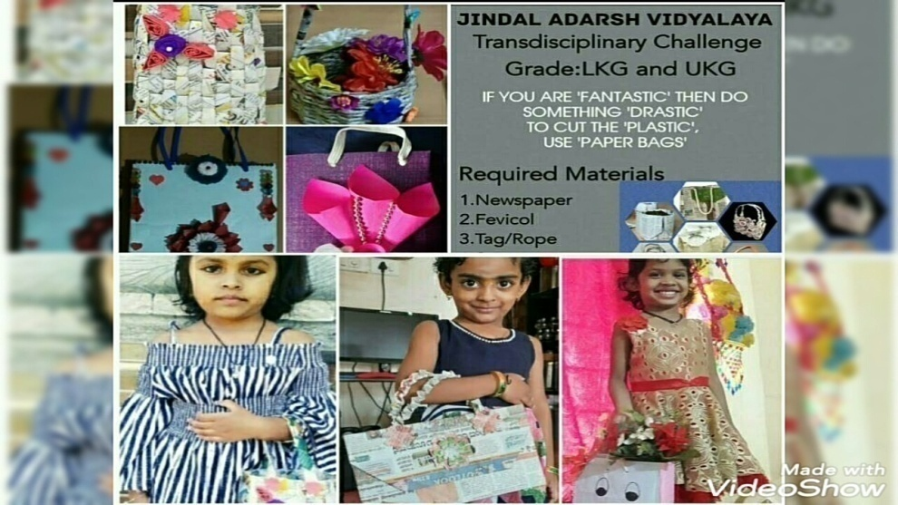
Transdisciplinary Challenge

Slide 14
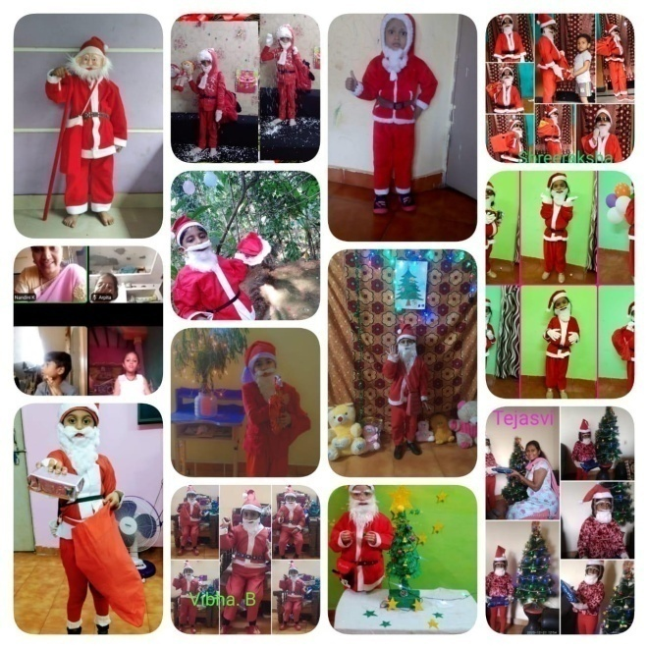
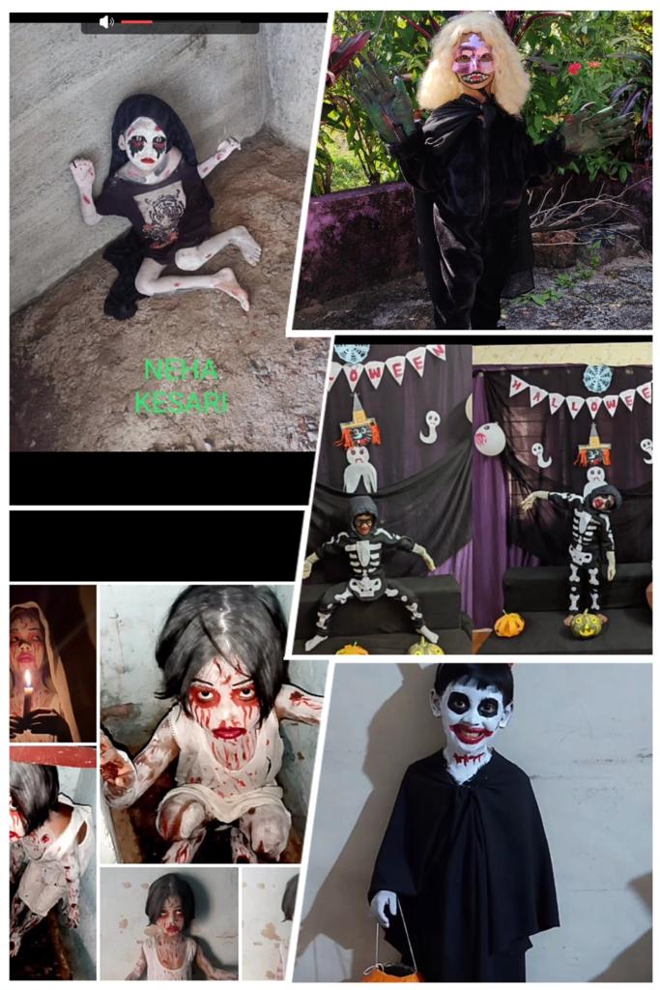
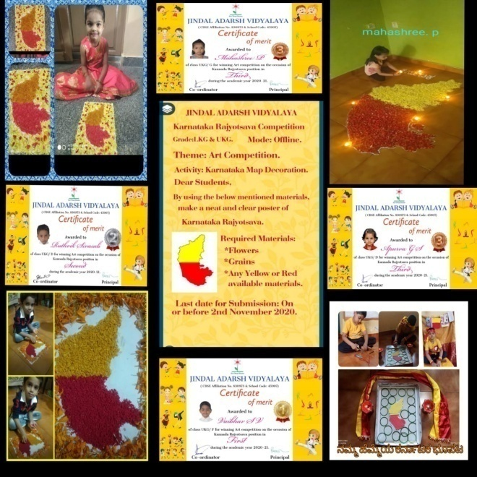
Competitions
Halloween
Kannada Rajyothsava
Fancy Dress

Slide 15
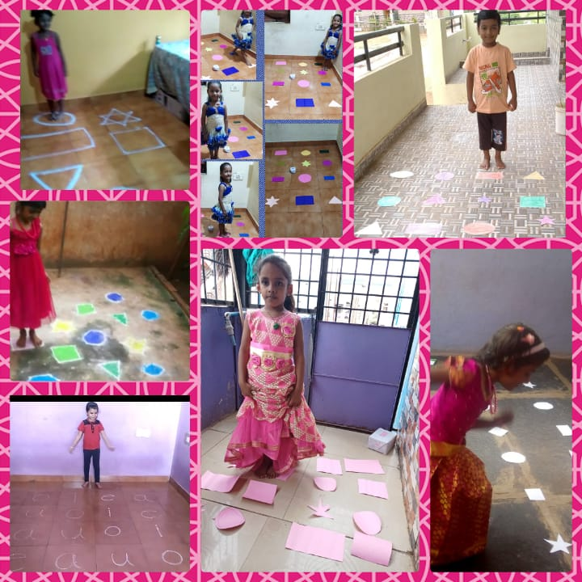
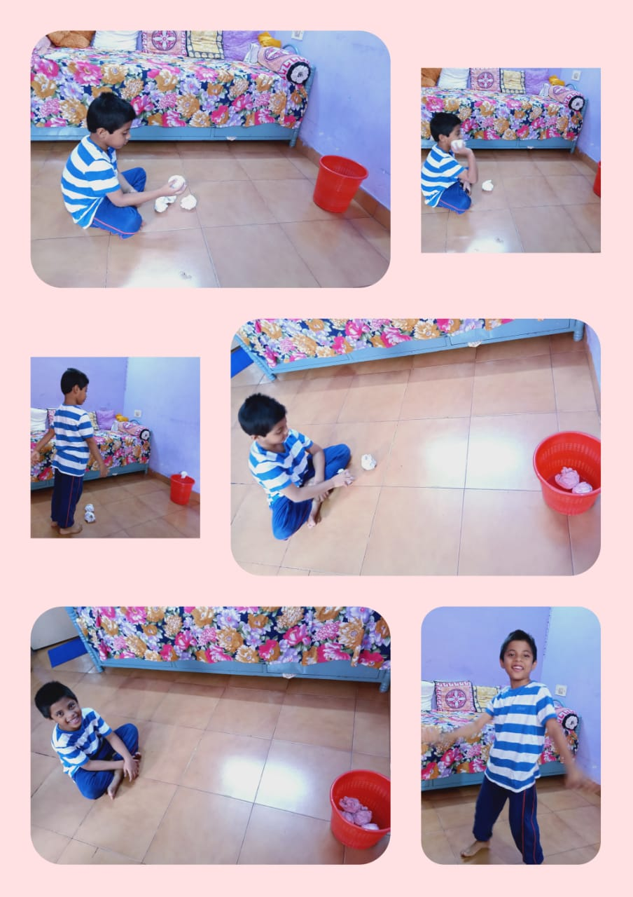
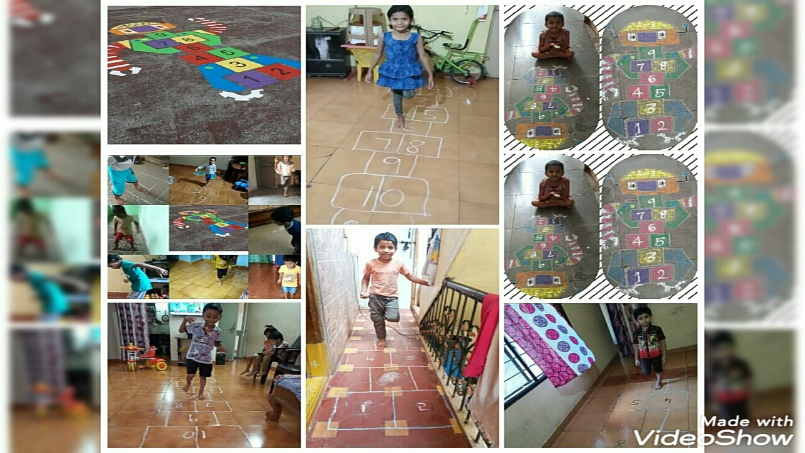
Sports

Slide 16
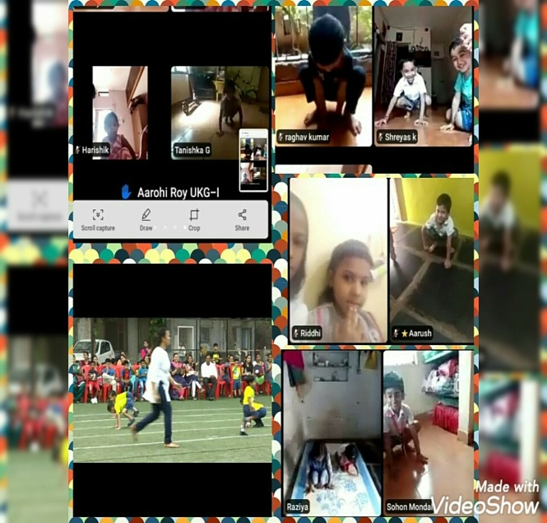
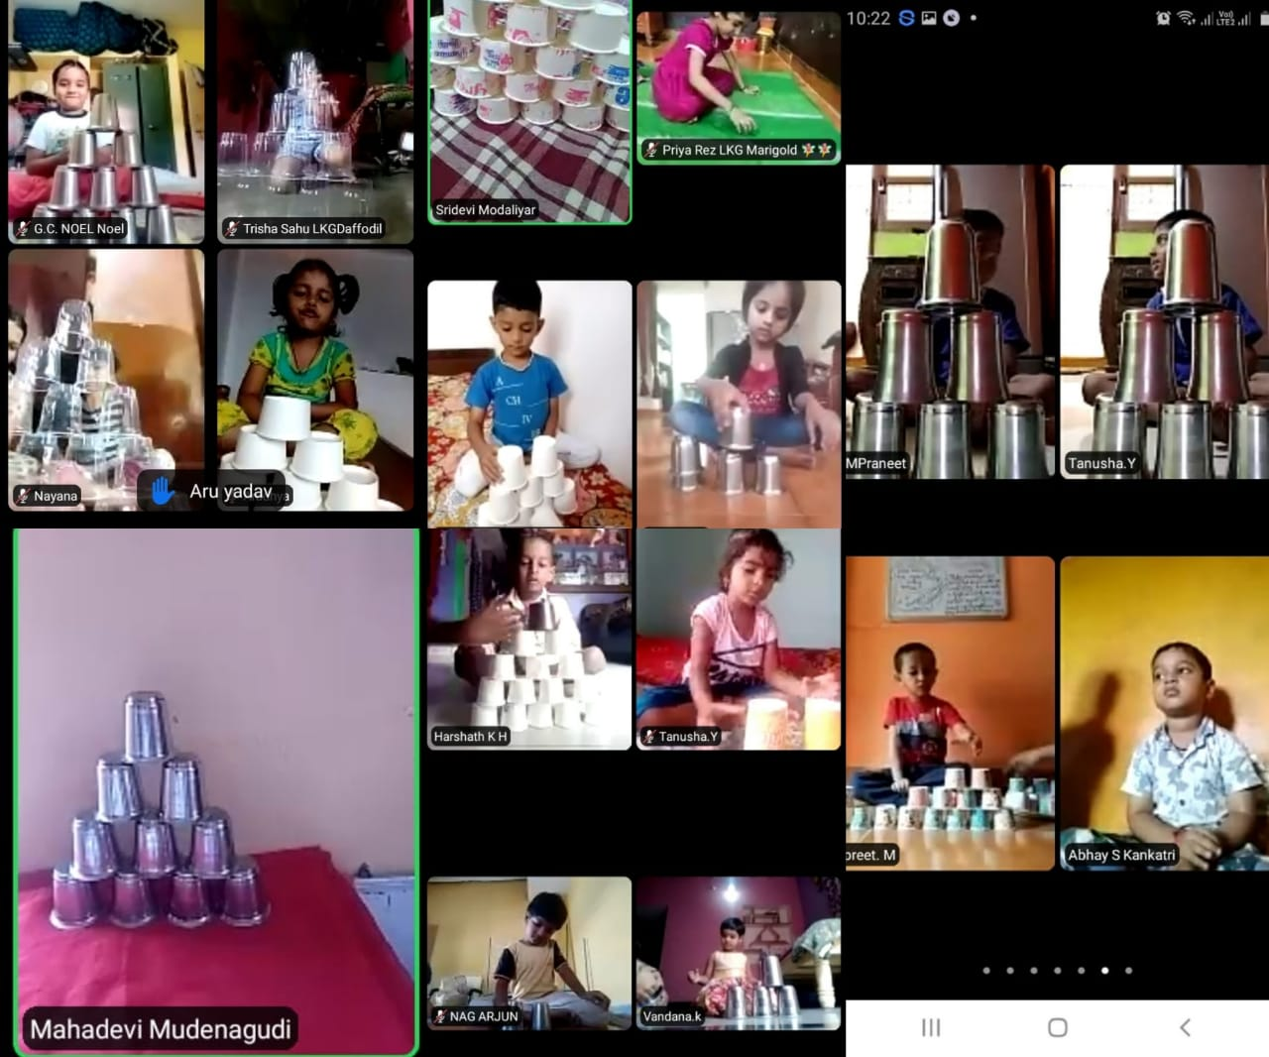
Congloms
Frog Race

Slide 17
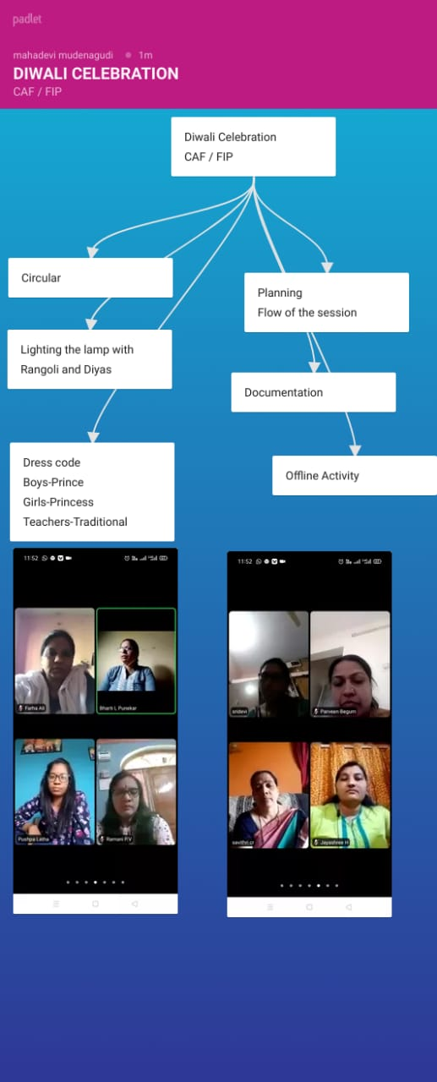
Virtual Planning

Slide 18
Happy New Year 2021
Thankyou

