Slide 1
JINDAL VIDYA MANDIR Kalmeshwar
Result Analysis Class -X
(A.Y. 2021-22)

Slide 2
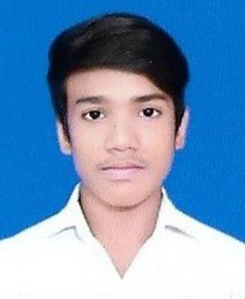
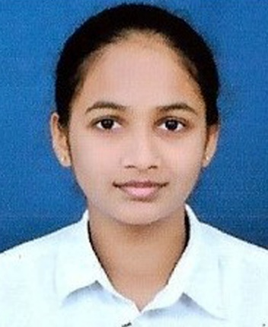
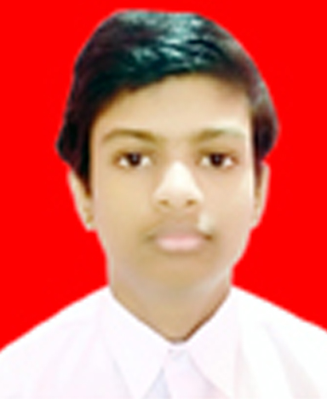
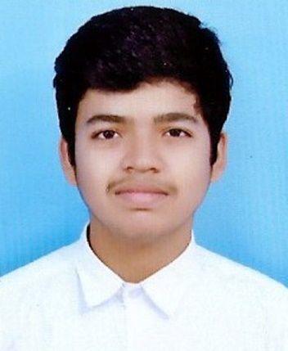
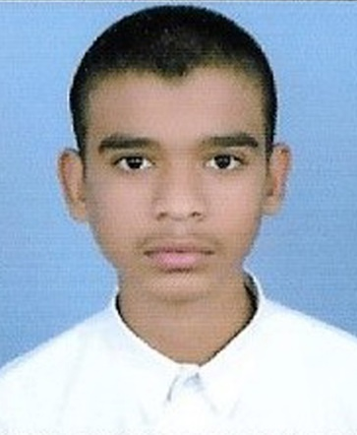
TOPPERS
2nd Rank
3rd Rank
1st Rank
PHOTO
PHOTO
PHOTO
SHAHID SYED(92%)
DIVYAL GATHIBANDHE
(90.8%)
4th Rank
PHOTO
5th Rank
PHOTO
PHOTO
CHINMAY KANFADE(92.2%)
ISHANT MALADHARI
(89.6%)
NIHAL JAMGADE(89%)

Slide 3
STUDENTS PROPORTION – PERFORMANCE WISE
No of Students - 31

Slide 4
STUDENTS PROPORTION – PERCENTAGE WISE
Total Students - 31

