Slide 1
JINDAL VIDYA MANDIR Kalmeshwar
Result Analysis Class -X
(A.Y. 2022-23)

Slide 2
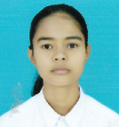
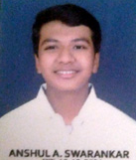
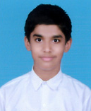
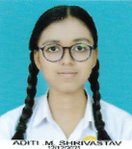
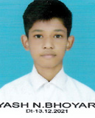
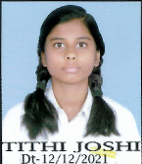
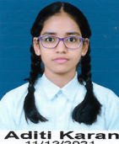
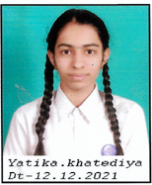
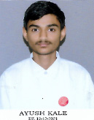
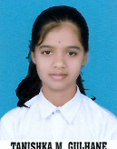
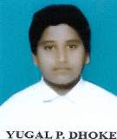
TOPPERS
2nd Rank
3rd Rank
1st Rank
PHOTO
PHOTO
PHOTO
APEKSHA SINGH(92.20%)
ANSHUL SWARNKAR(91%)
4th Rank
PHOTO
5th Rank
6th Rank
7th Rank
8th Rank
PHOTO
ADITI KARAN
(87.80%)
YATIKA KHATEDIYA
(86.80%)
AYUSH KALE
(86.40%)
TANISHKA GULHANE
(86.20%)
YUGAL DHOKE
(85%)
SHUBHAM ASARE(94%)
ADITI SHRIVASTAV
(88.80%)
YASH BHOYAR
(88.40%)
TITHI JOSHI
(88%)

Slide 3
STUDENTS PROPORTION – PERFORMANCE WISE
No of Students - 25

Slide 4
STUDENTS PROPORTION – PERCENTAGE WISE
Total Students - 25

