Slide 1


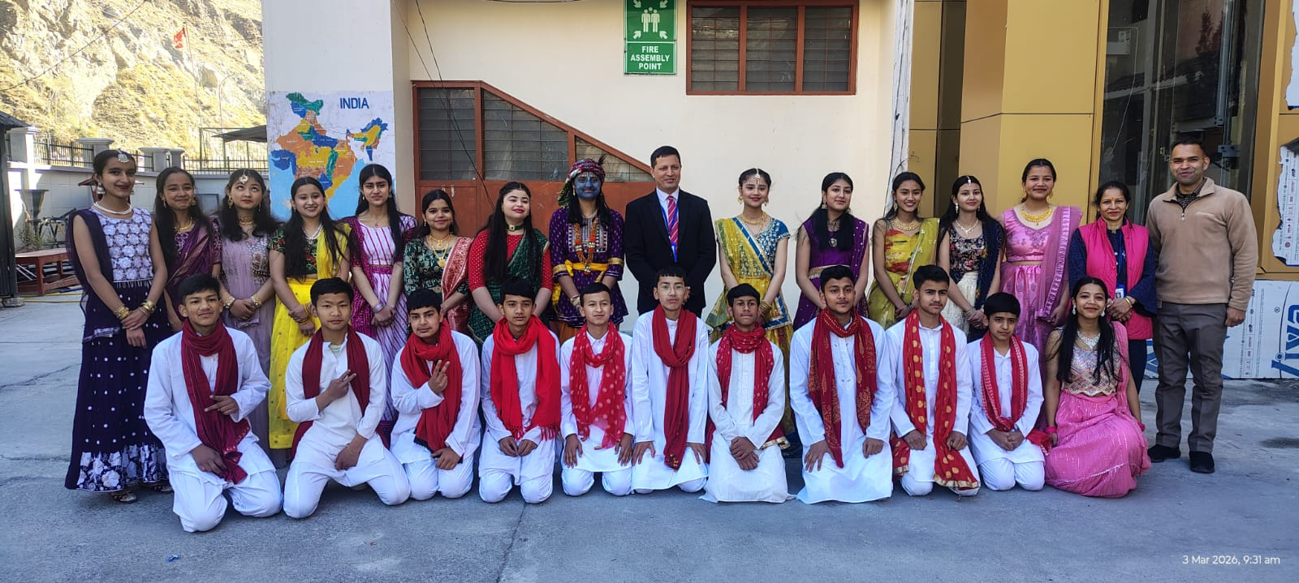
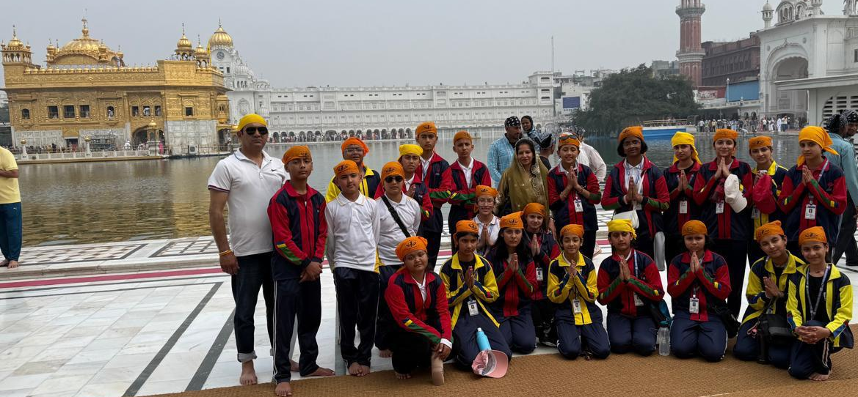
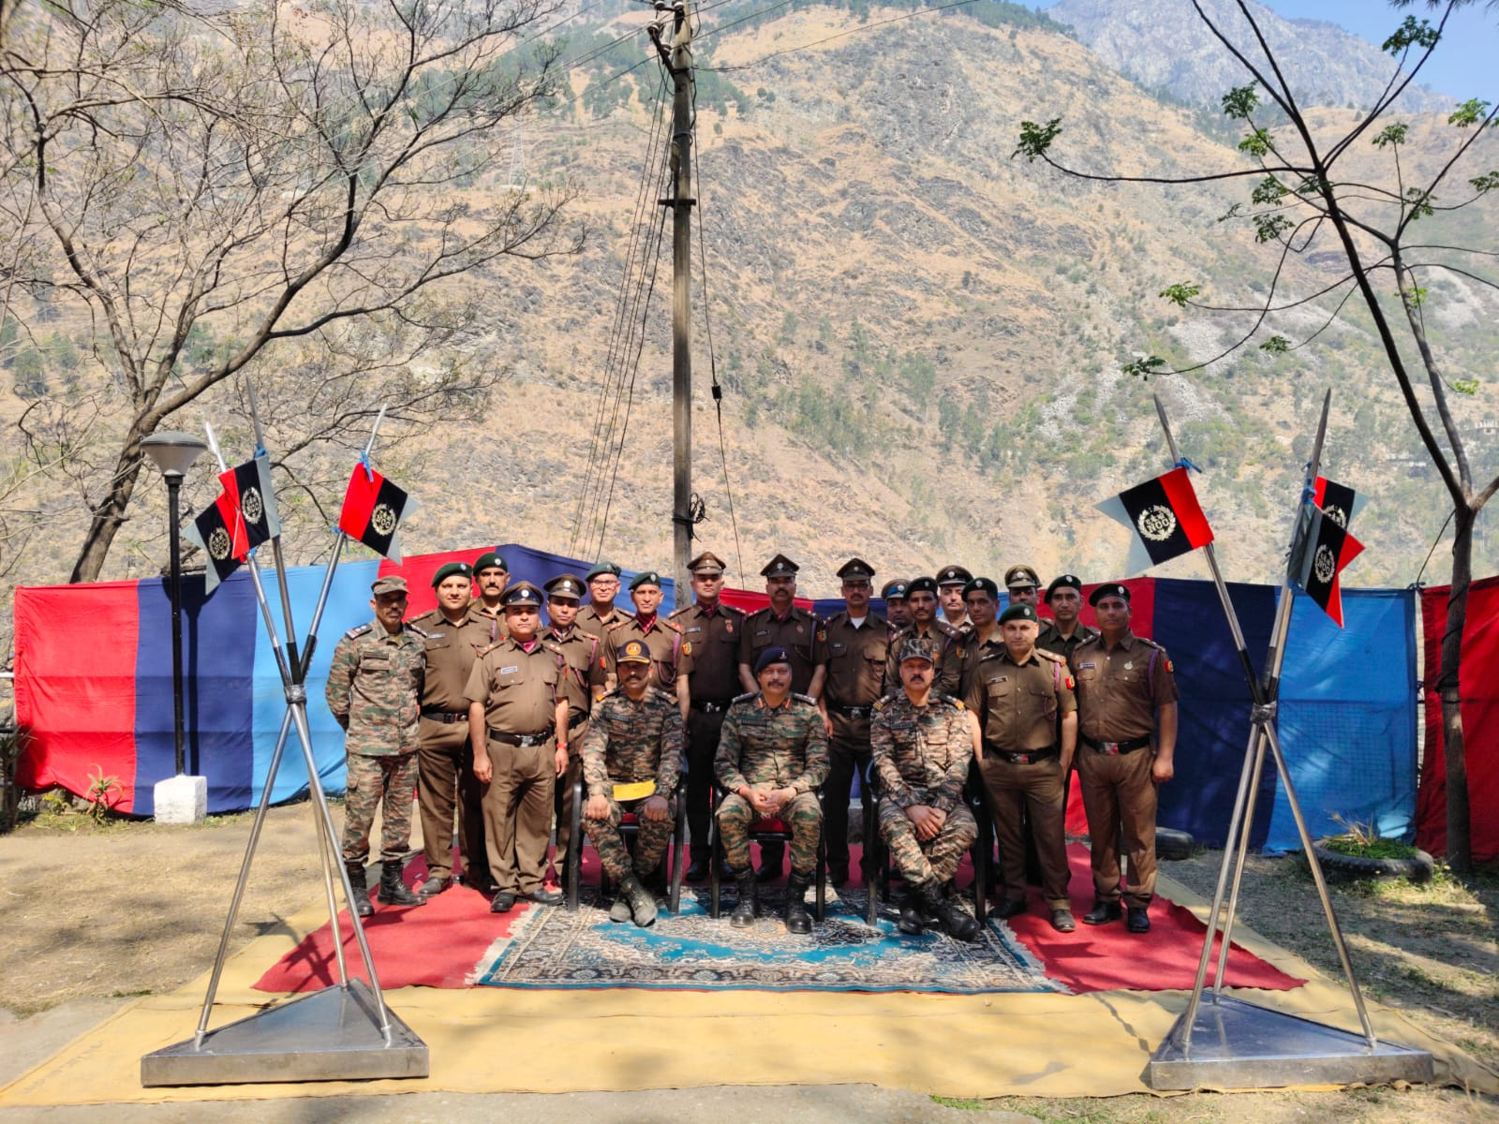
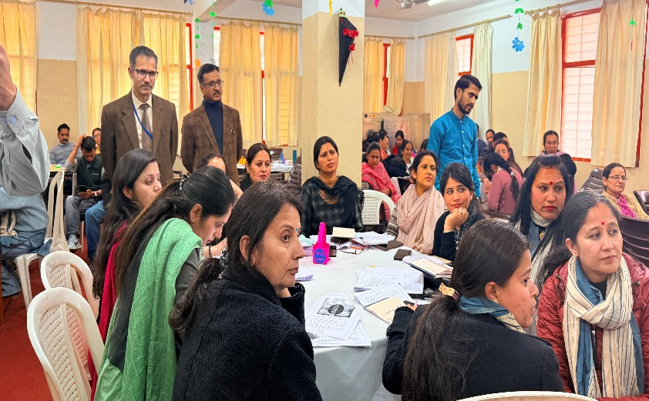

SHOLTU leaflet
Mar 2026
What’s Inside
# Holi-Spread love, Not just colors
# CBSE CBP 1 Day Program
# Online training-Diksha Platform
# Special Assembly on Eid al-Fitr
# An Educational Tour
# HPV Awareness Session
# Ram Navami-Jai Siya Ram
# Among the Best: Akira Zintoo Shines
in Sainik School”
THE OFFICIAL NEWSLETTER OF JINDAL VIDYA MANDIR
“Every Day Every Child A Leader”

Slide 2
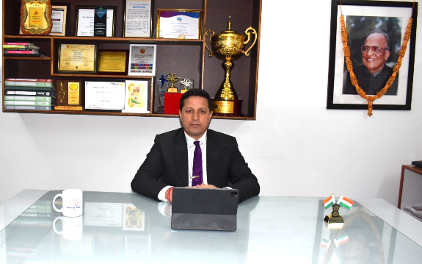

From Principal’s Desk
Dear readers
Greetings!
The future can feel exciting, mysterious, and even a little scary. With the world changing so fast, many students wonder: how can I be ready for what’s coming? With the right mindset, students can build on what you know and be ready to take on any challenge the future brings. Everyone has strengths. Maybe you are great at solving puzzles, writing stories, helping friends, or staying organized. These are all important skills. Start by identifying what you are good at and what you enjoy doing. Your current strengths can guide you toward future goals. For example, if you are good at explaining things, you might one day become a teacher, coach, or even a scientist. Skills grow when you practice and challenge yourself. If you like drawing, try learning digital art. If you are good at math, explore coding or robotics. Use your school projects and hobbies to push your abilities further. Even reading more books can expand your thinking, vocabulary, and creativity. You don’t need to wait for the future to start preparing for it. Every new thing you learn today adds to your skill set for tomorrow. The world is always changing, especially with new technologies and ideas. The best way to stay ready is to stay curious. Ask questions. Try new things. Learn from mistakes. Curiosity helps you adapt to change, which is one of the most important skills in life. Being open to learning means you’re never stuck. Even if something is difficult at first—like a new subject or a new way of doing things—you can figure it out with time and effort. Challenges are part of life, and they often help us grow the most. Whether it’s a tough subject in school, a personal problem, or a big change, try to see challenges as opportunities. When you overcome them, you gain confidence and new skills. Talk to your teachers, friends, or family when you need help. You don’t have to face everything alone. Working with others and asking for support is also a powerful skill.
In addition to academic skills, life skills are just as important. These include communication, time management, teamwork, and resilience. Being kind, respectful, and responsible also builds a strong foundation for your future success, both in school and in life. It is great to have big dreams, like becoming a doctor, engineer, artist, or entrepreneur. But remember, every big goal starts with small steps. Focus on doing your best today. Be consistent, stay positive, and believe in your ability to learn and improve.
The future is full of possibilities. By using your existing skills, staying curious, and facing challenges bravely, you can shape a future that is bright and full of success.
Wishing you a joyful, enriching, and purpose-filled summer! Your proud principal
Bikram Singh Negi
Page 2 of 31

Slide 3
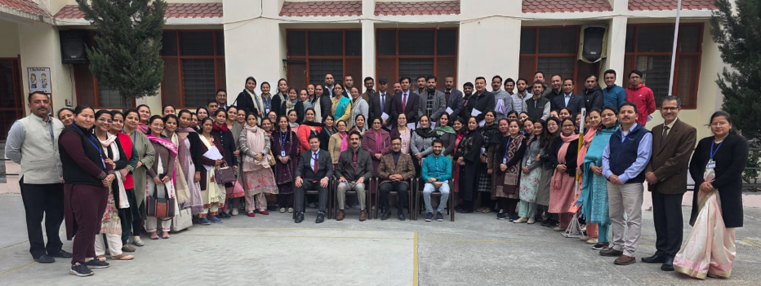

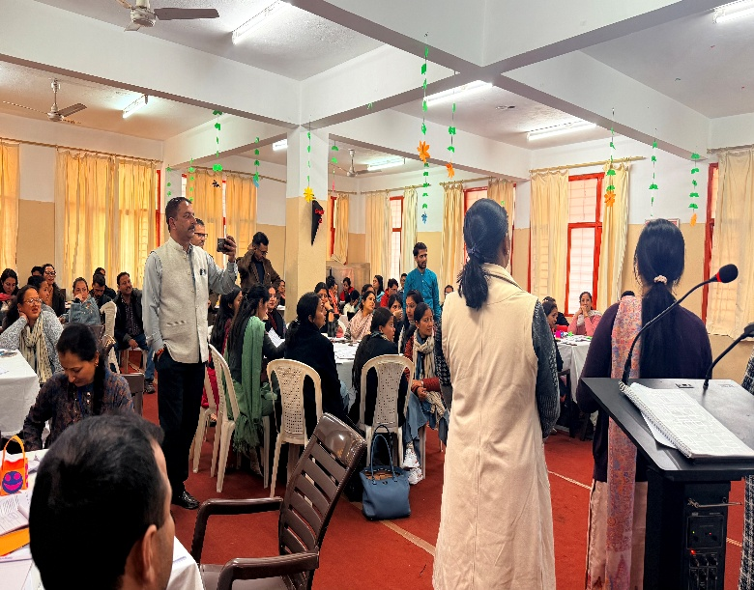
CBSE CBP 1 Day Program
An enriching offline workshop on “Learning Outcomes” was attended by the teachers of our school along with educators from other founding schools. The workshop was conducted under the guidelines of the Central Board of Secondary Education, aiming to strengthen teaching practices and improve student learning. The session was led by the resource person, Mr. Ravi Sharma and Mr. Karan Sood, who shared valuable insights into the importance of clearly defined learning outcomes in the teaching-learning process. They emphasized how outcome-based education helps in making lessons more focused, measurable, and student-centered. Through interactive discussions and practical examples, the participants gained a deeper understanding of aligning classroom instruction, activities, and assessments with desired learning outcomes. The workshop also provided a platform for teachers to exchange ideas and best practices. The session proved to be highly informative and engaging, equipping educators with effective strategies to enhance classroom delivery and ensure better academic achievement of students.

Slide 4
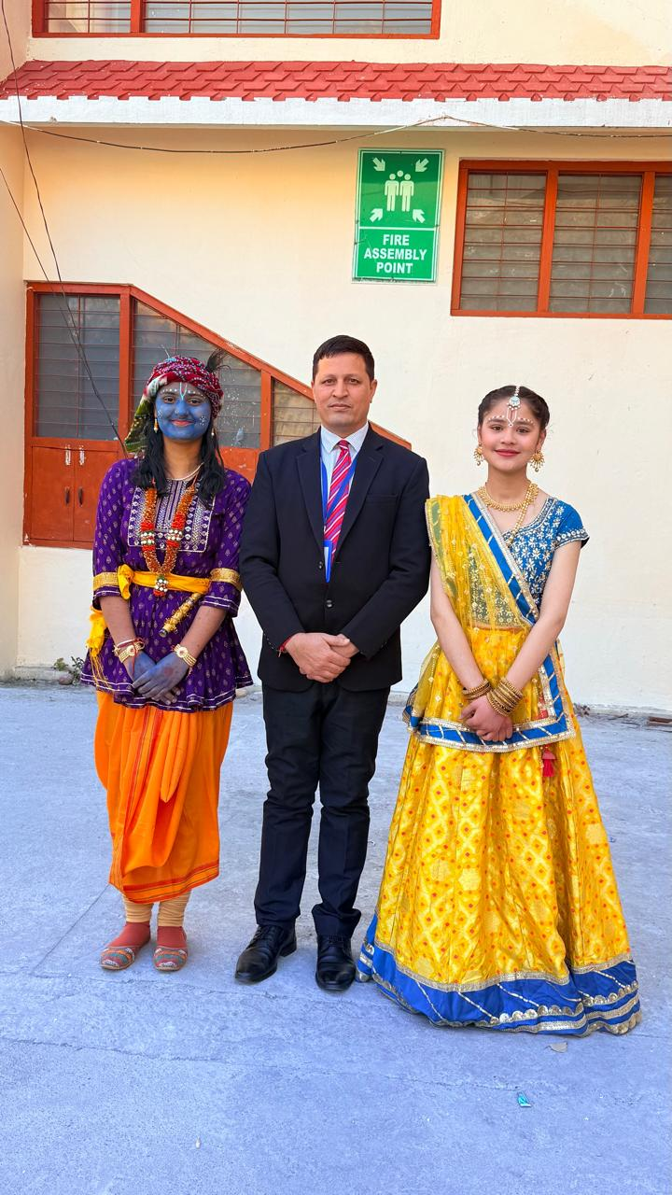
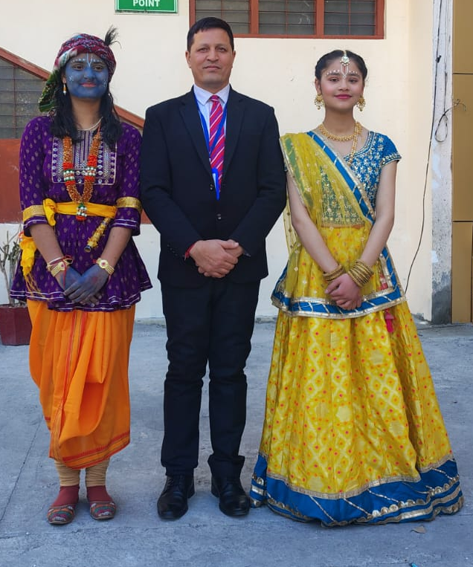
Special Assembly on Holi Holi-Spread love, Not just colors
A special assembly on Holi was organized in our school and was presented by the students of Class X. The assembly was full of colour, joy, and enthusiasm. The programme began with the morning prayer. After that, the students of Class X presented a beautiful dance performance on lively Holi music. They performed with great enthusiasm and energy, which made the atmosphere cheerful and festive. The colourful costumes and joyful expressions of the students made the performance even more enjoyable. Principal Sir and teachers and students appreciated the efforts of the students with loud applause for their wonderful performance.

Slide 5
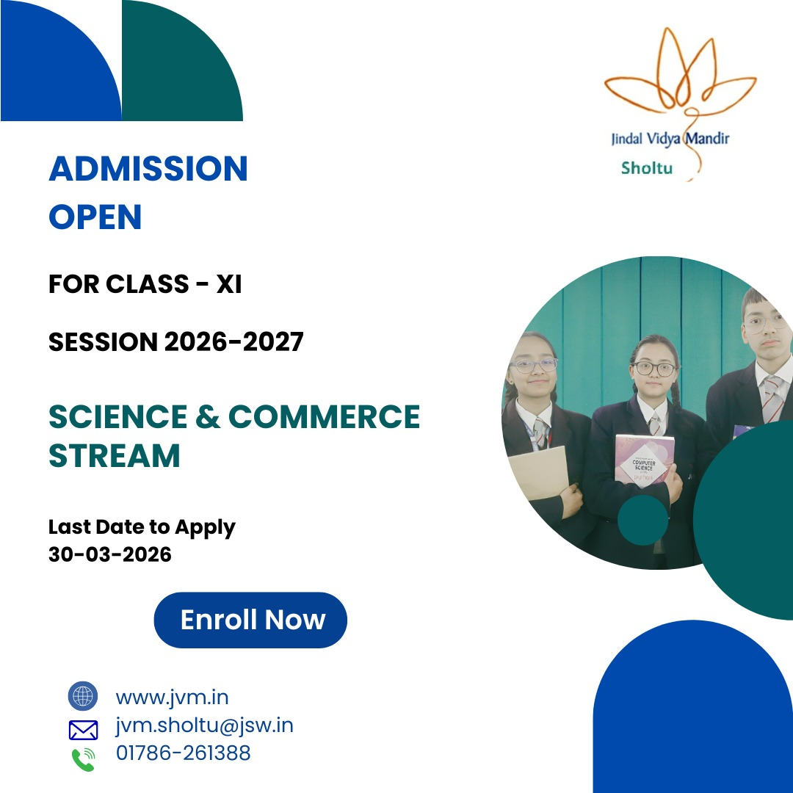
Expansion of Academic Horizons: Commerce Stream Introduced at JVM Sholtu
JVM Sholtu has taken a significant step forward this year by introducing the Commerce stream alongside Science, further expanding its academic offerings. This new addition provides students with greater flexibility to choose subjects that align with their interests, strengths, and long-term career aspirations in fields such as business, finance, management, and entrepreneurship.
With a focus on quality education, experienced faculty, and a supportive learning environment, the school aims to nurture well-rounded individuals prepared for future challenges. The introduction of the Commerce stream reflects the institution’s commitment to providing diverse opportunities and holistic development for its students.
Admissions for the Commerce stream are now open. Interested students and parents are encouraged to complete the admission process at the earliest and take a confident step toward a bright and successful future.

Slide 6
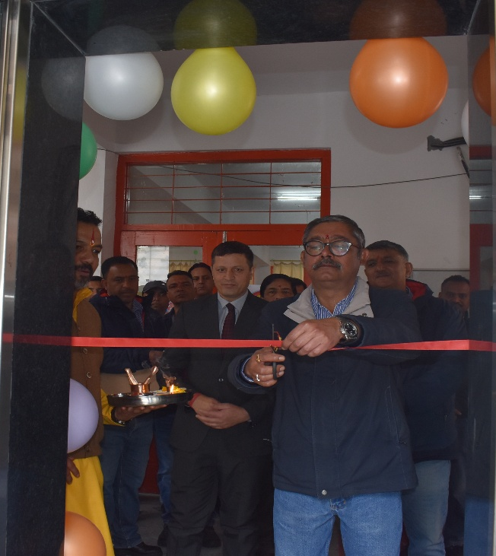
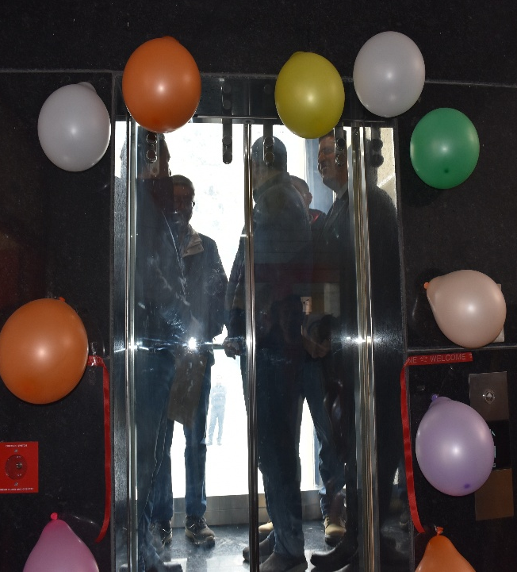
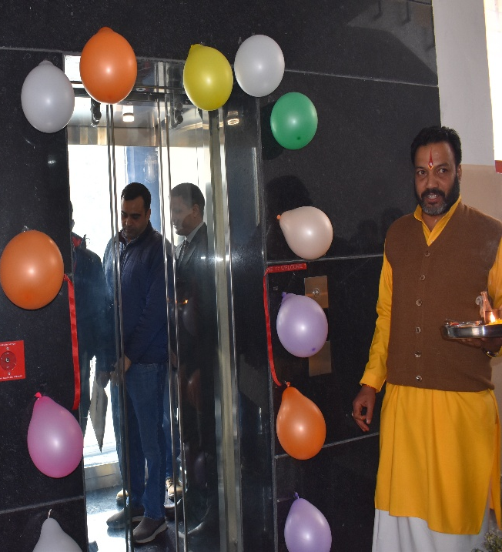
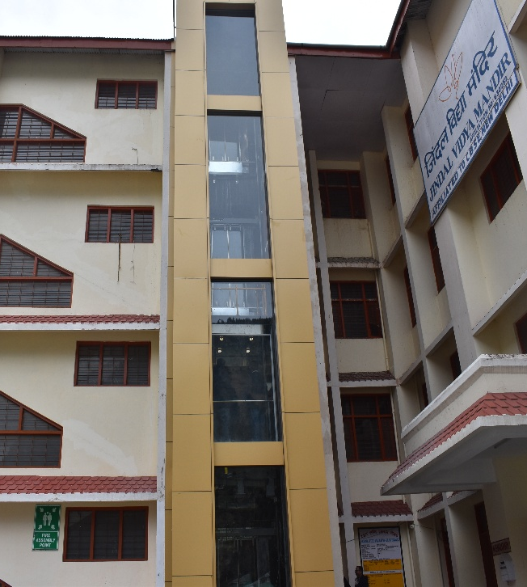
Enhancing Accessibility: Lift Inauguration at JVM Sholtu School
Lift Inauguration at JVM Sholtu School was conducted successfully. The inauguration ceremony was carried out by Plant Head Mr. Kaushik Maulik, marking a significant milestone in the school’s commitment to improving infrastructure and accessibility. The newly installed lift will benefit students, staff, and visitors, especially those with mobility challenges, by ensuring safe and convenient movement within the premises. The event was attended by school authorities, staff members, and students, making it a memorable and meaningful occasion. This initiative reflects the school’s dedication towards creating an inclusive, modern, and student-friendly environment.

Slide 7

Teachers Attend CBSE Online Training on DIKSHA Portal
In line with its commitment to excellence in education, the teaching staff of our school actively participated in various online training programmes conducted by the Central Board of Secondary Education through the DIKSHA Portal. These training sessions were aimed at enhancing the professional competencies of teachers and keeping them updated with the latest educational practices. The modules covered important areas such as competency-based learning, innovative teaching strategies, effective assessment techniques, and the integration of digital tools in classroom teaching. Our teachers showed great enthusiasm and dedication by actively participating in these programmes and successfully completing multiple courses. The knowledge and insights gained through this initiative will significantly contribute to making classroom teaching more engaging, effective, and learner-centered.
S NO | Staff Name
1 | RITA DEVI
2 | SANJEEV KUMAR .
3 | LALIT KUMAR
4 | SANDHYA SHARMA
5 | BHUPENDER .
6 | KULWANT SINGH
7 | ANUPMA BHANDARI
8 | AARTI SHARMA
9 | AMITA NEGI
10 | DINESHWARI NEGI
11 | PREMLATA SHARMA
12 | URVASHI LARZOO
13 | MADHU BHARDWAJ
14 | TSULTRIM GYATSO
15 | VEENU .
16 | VIKAS CHANDER
17 | KISHORI LAL
18 | SEEMA DEVI
19 | HIMMAT SINGH
20 | MEENAKSHI RAWAT
21 | KIRAN BALA
22 | DEEPTI GUPTA SIRKECK
23 | KOSHLAYA DEVI
24 | ANJANA ABROL
25 | RAJEEV THAKUR
Page 5 of 27

Slide 8
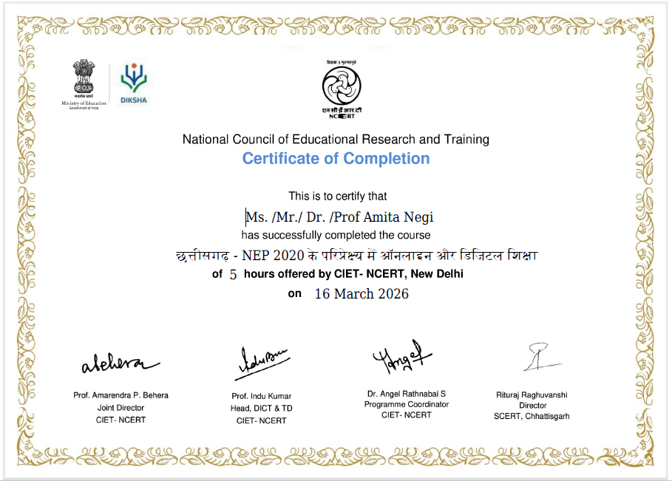
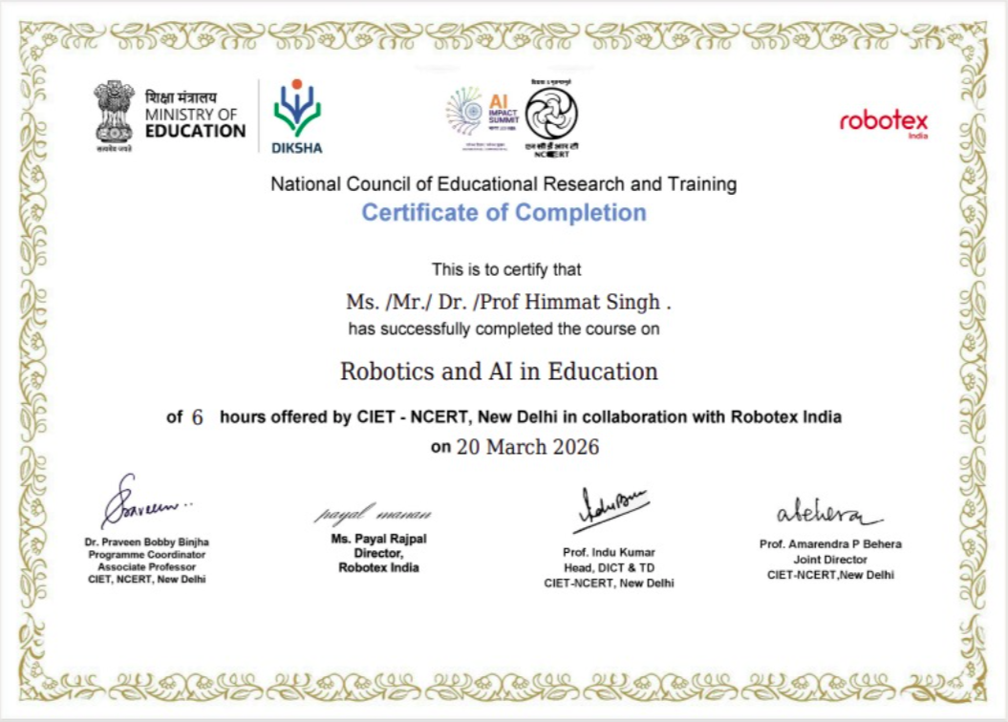

Slide 9
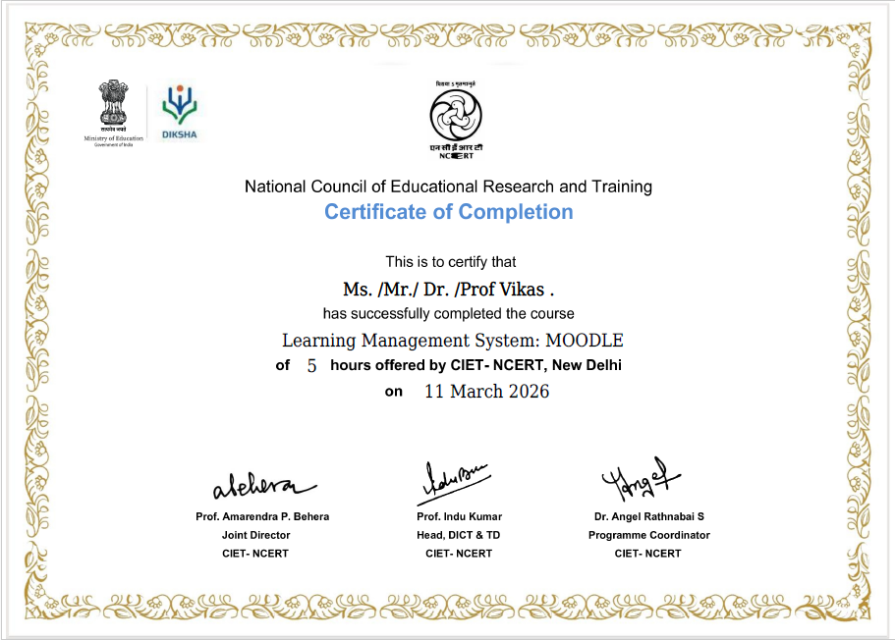
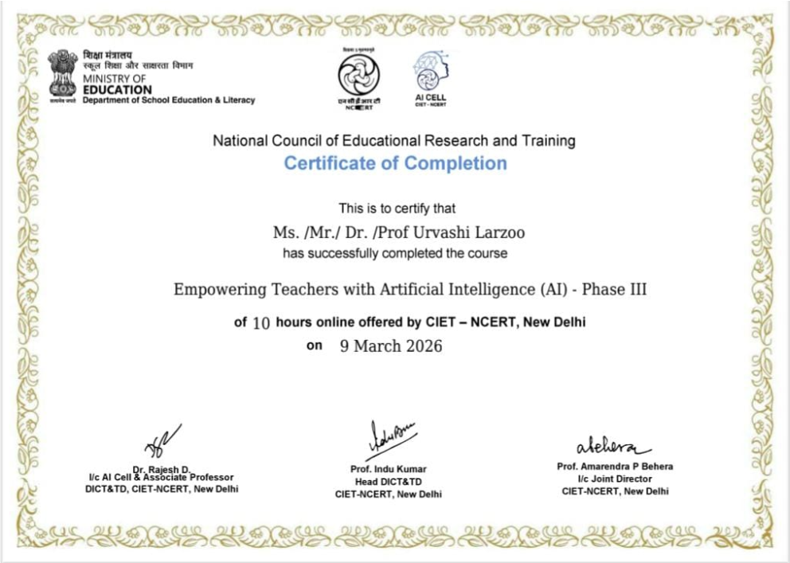

Slide 10
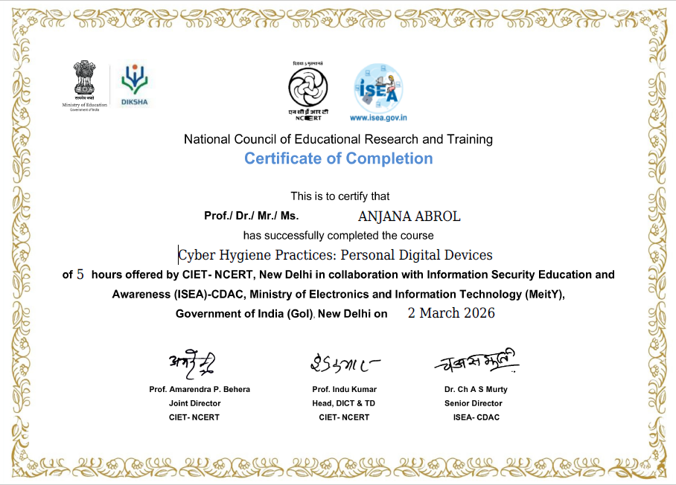
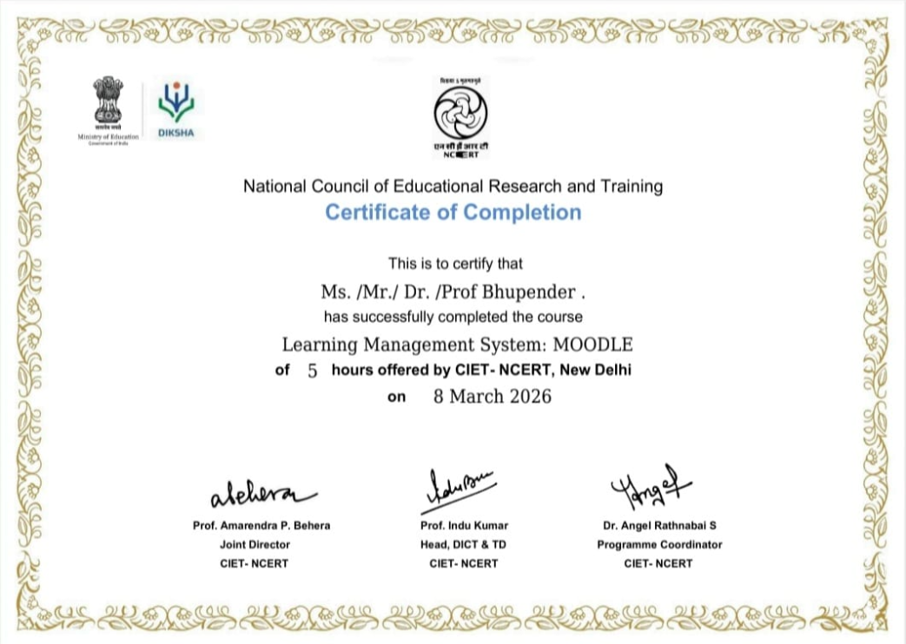

Slide 11
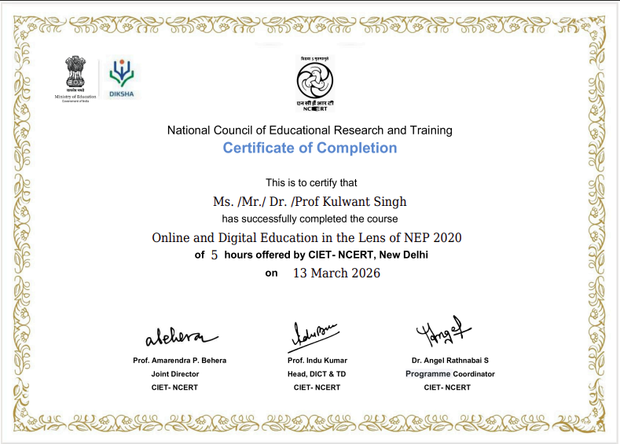
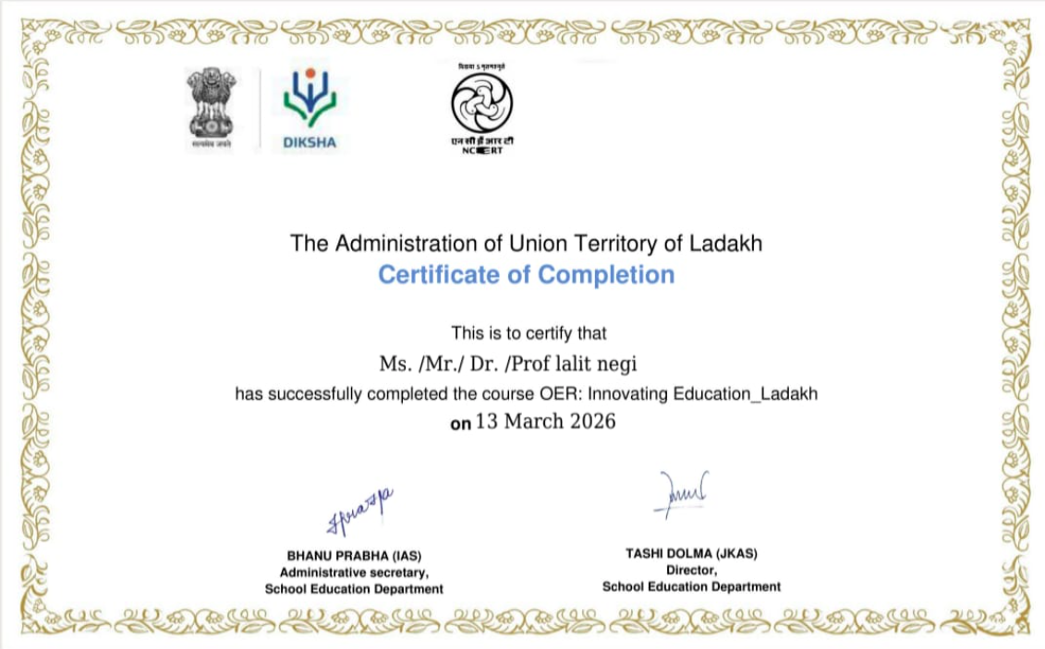

Slide 12
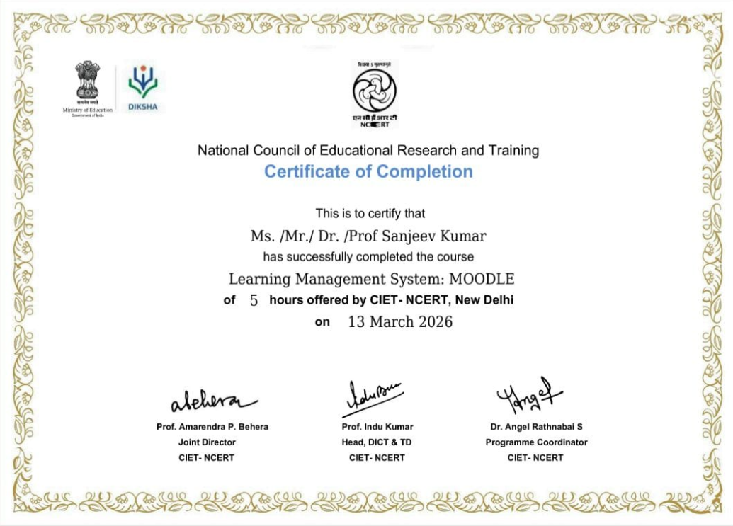
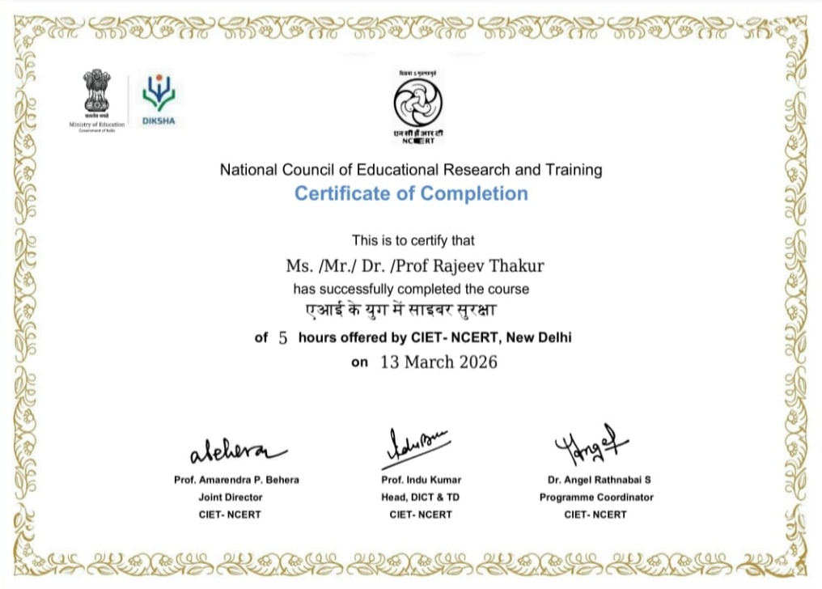

Slide 13
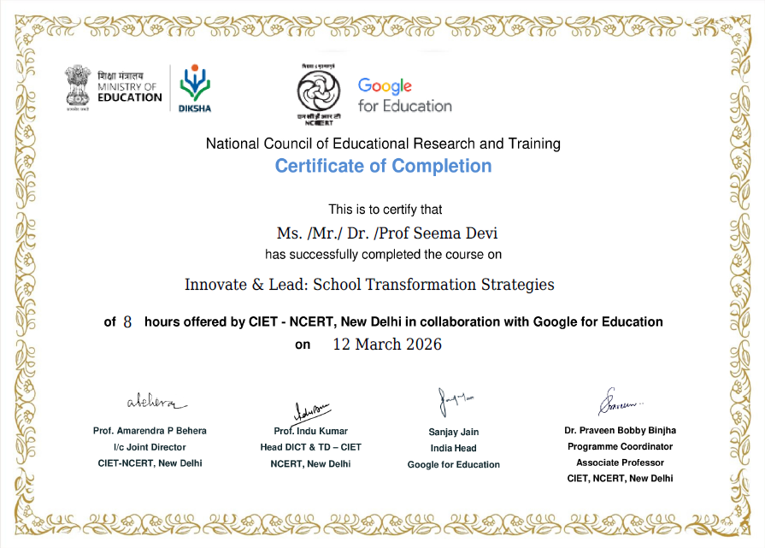
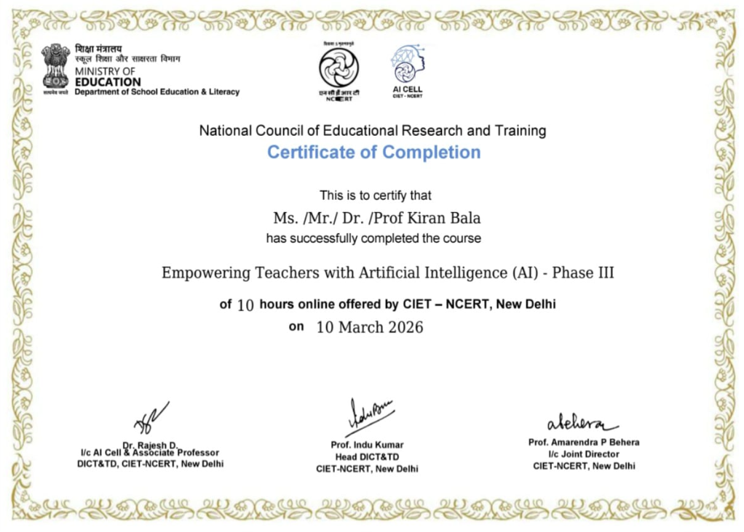

Slide 14
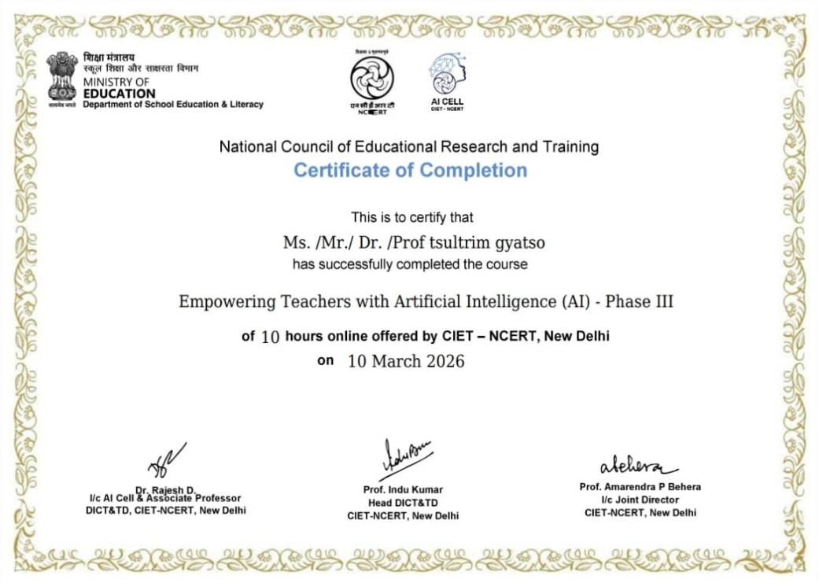
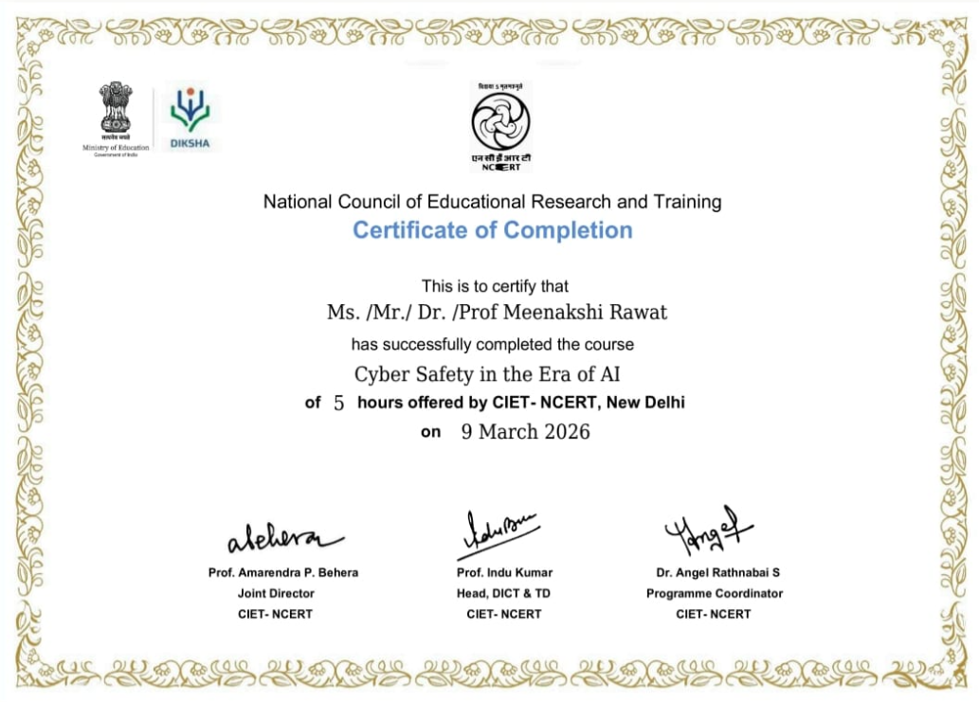

Slide 15
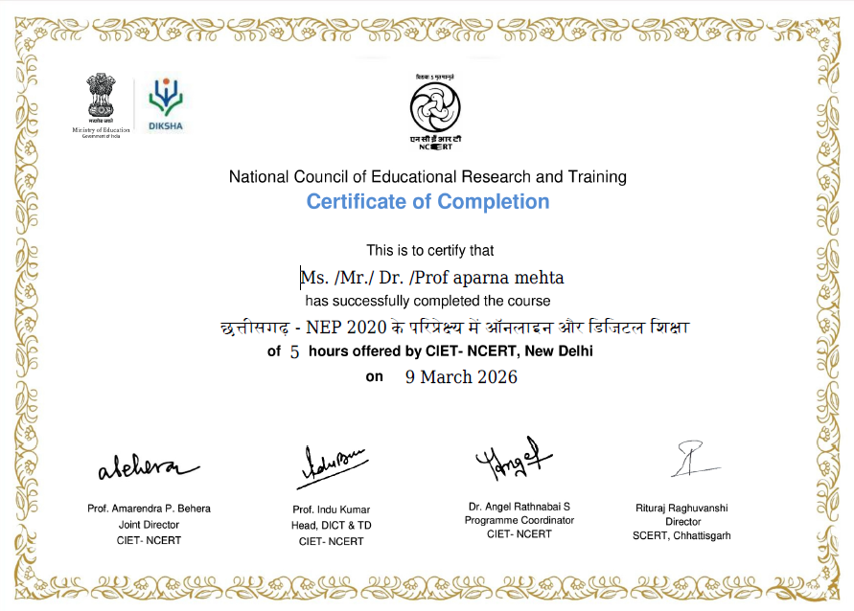
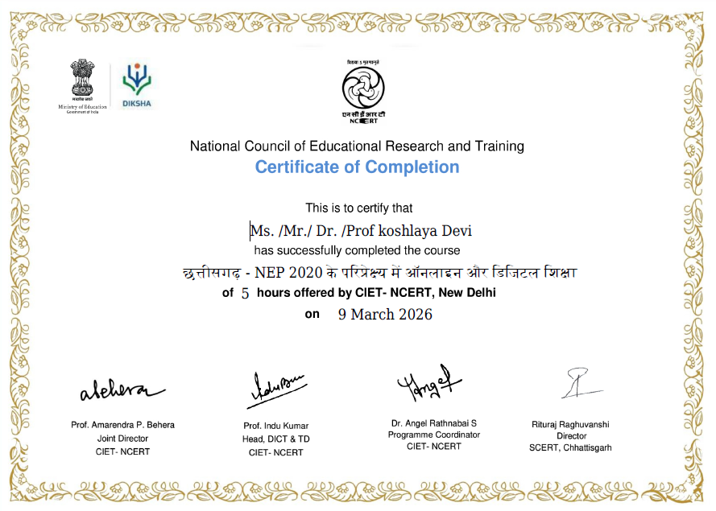

Slide 16
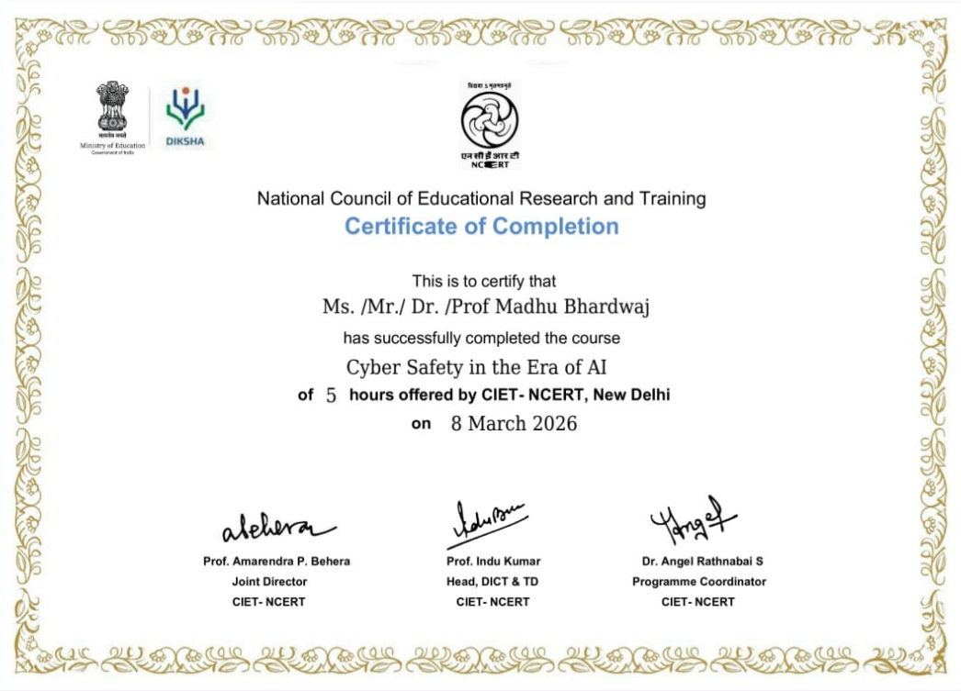
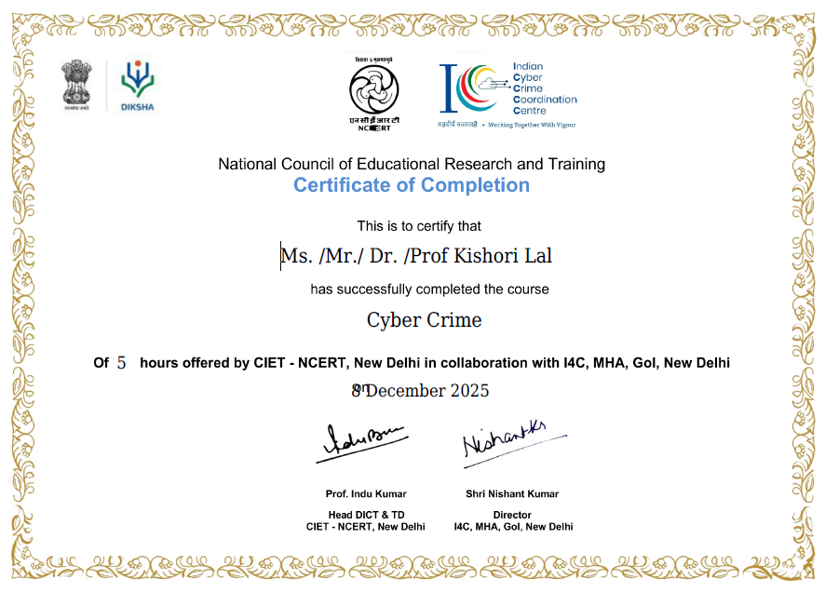

Slide 17
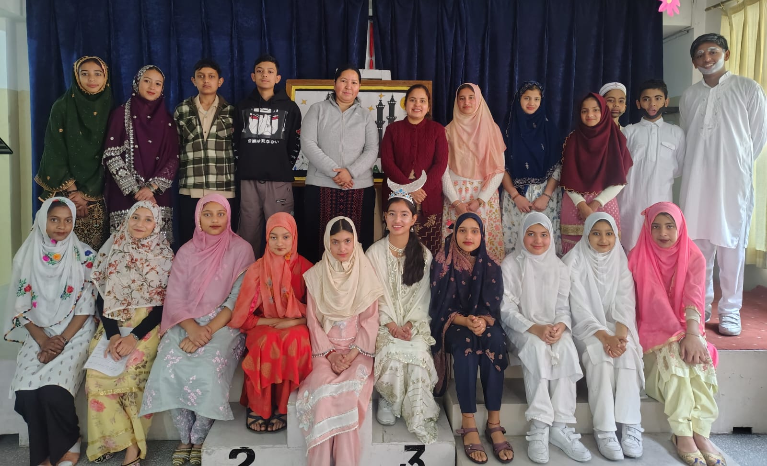
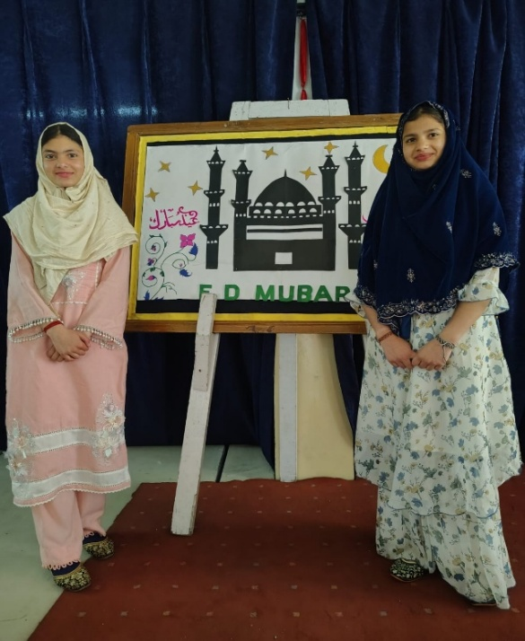
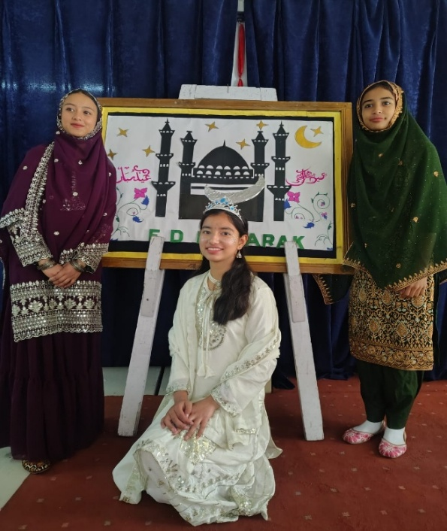
Special Assembly on Eid al-Fitr
Celebration of Id-Ul-Fitr by Class IX Students The students of Class IX enthusiastically celebrated the spirit of Eid al-Fitr through a delightful cultural presentation in the school. The programme featured a short and meaningful skit performed by the students, beautifully depicting the values of compassion, gratitude, and sharing that are central to the festival. Through their confident acting and expressive dialogue delivery, the students effectively conveyed the message of unity and kindness. Adding to the charm of the event, a group of students recited a soulful poem on Eid, highlighting the significance of forgiveness, joy, and togetherness. The presentation not only showcased the creative talents of the students but also helped in spreading awareness about the cultural and religious importance of the festival. It was a wonderful learning experience that promoted harmony and respect for diversity among students. The event was well appreciated by teachers and students alike, making it a memorable and meaningful celebration.

Slide 18
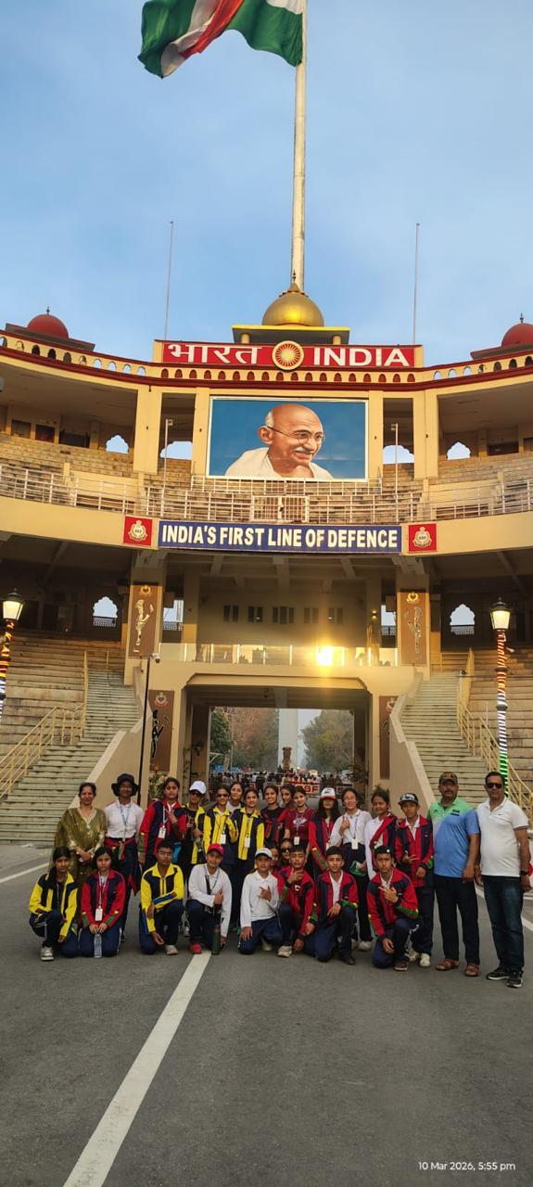
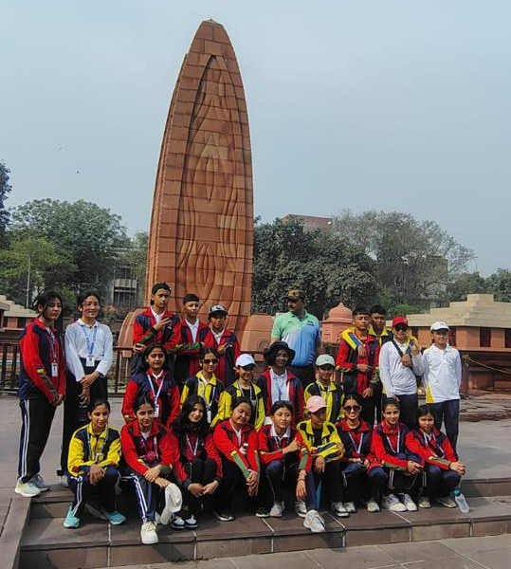
An Educational Tour
Our school recently organized an educational tour to some of the most famous places, including Lovely professional university, Golden Temple, Wagah Border, and various museums including the Science Museum. The tour began with great excitement. Another exciting highlight was the visit to the Wagah Border, where the students witnessed the energetic and patriotic retreat ceremony between India and Pakistan. It filled the hearts with pride and enthusiasm. Students also visited museums, including a science museum, where they learned many interesting facts about science and technology through interactive exhibits. This tour was not only enjoyable but also highly educational. It helped them to learn about history, culture, and national pride. It was truly an unforgettable experience that the students will cherish forever.

Slide 19
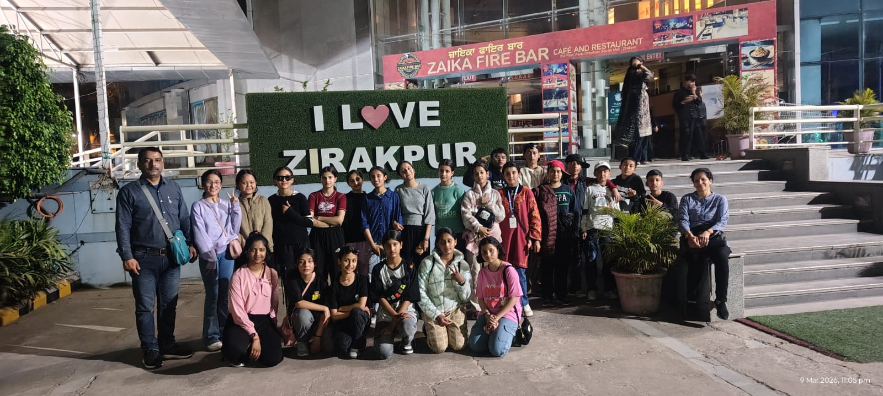
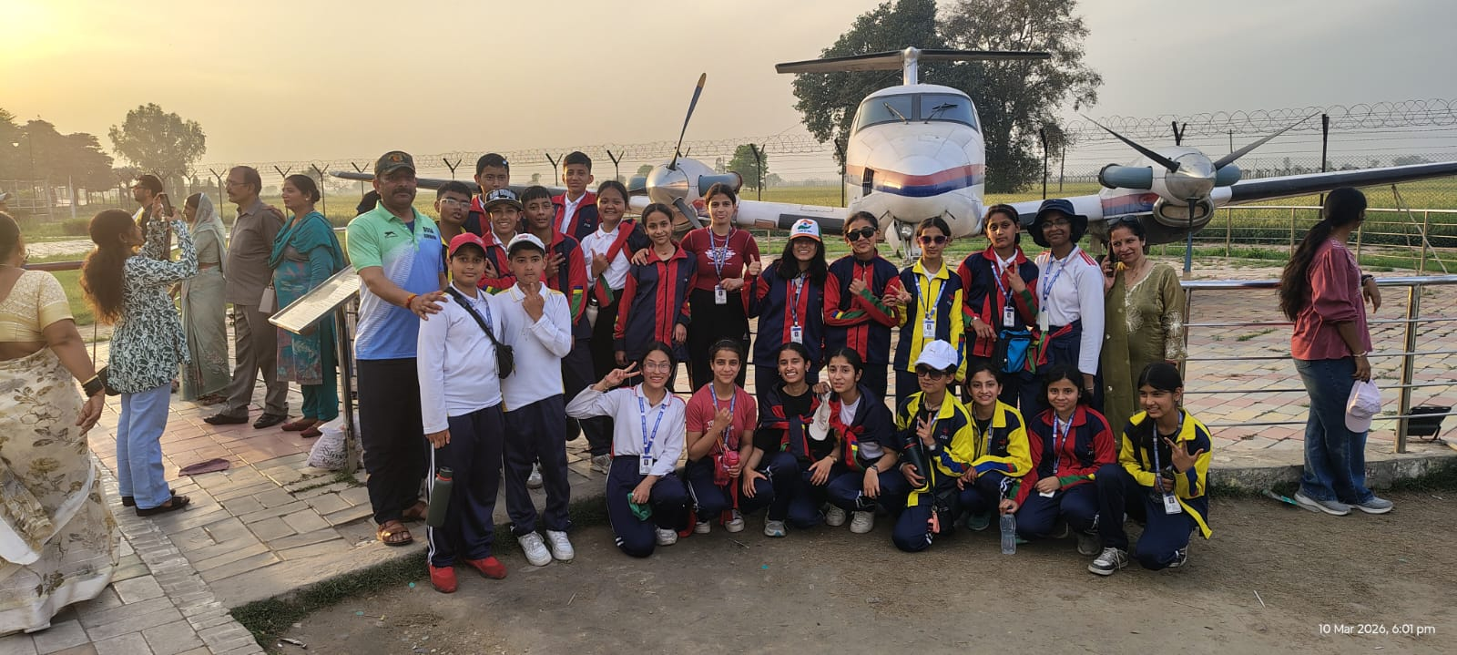
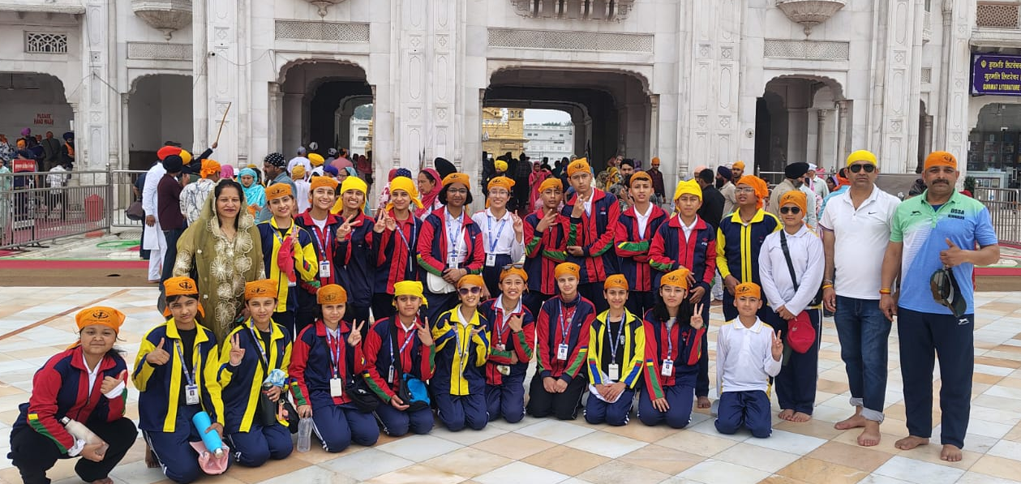

Slide 20
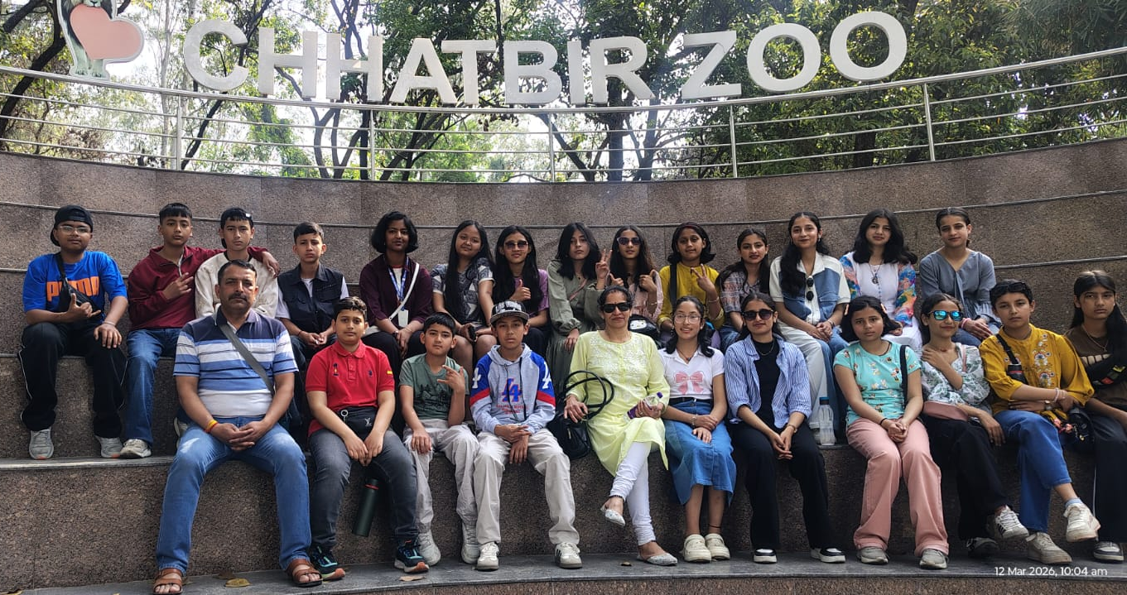
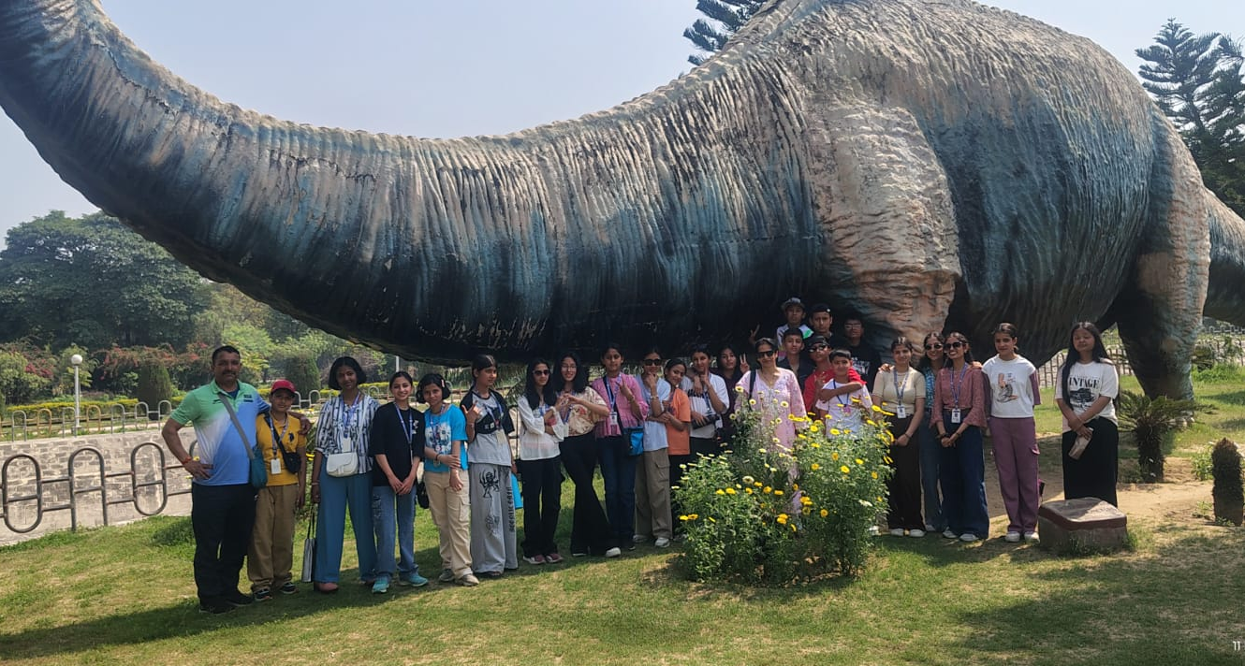
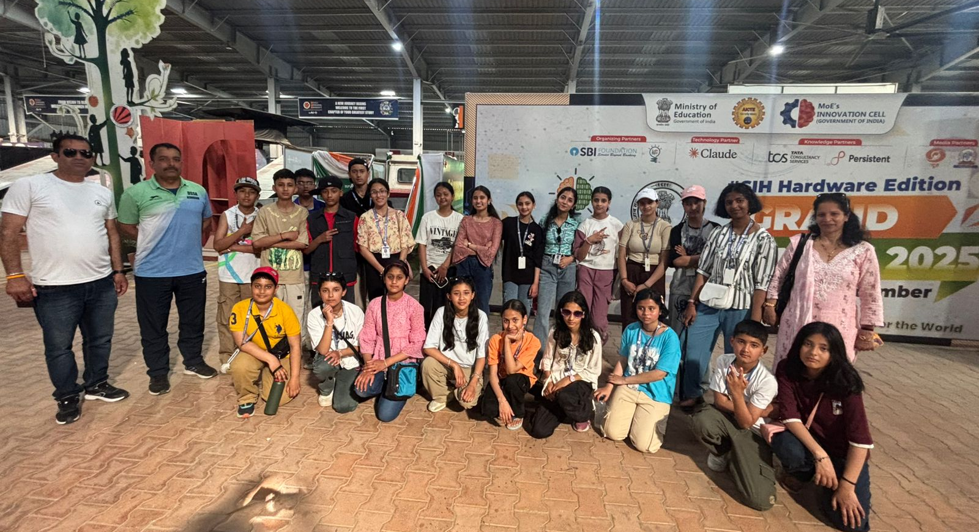

Slide 21
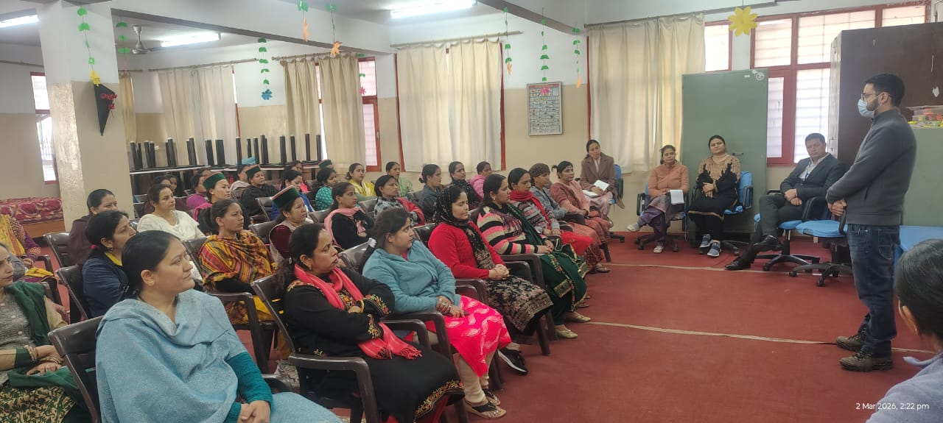
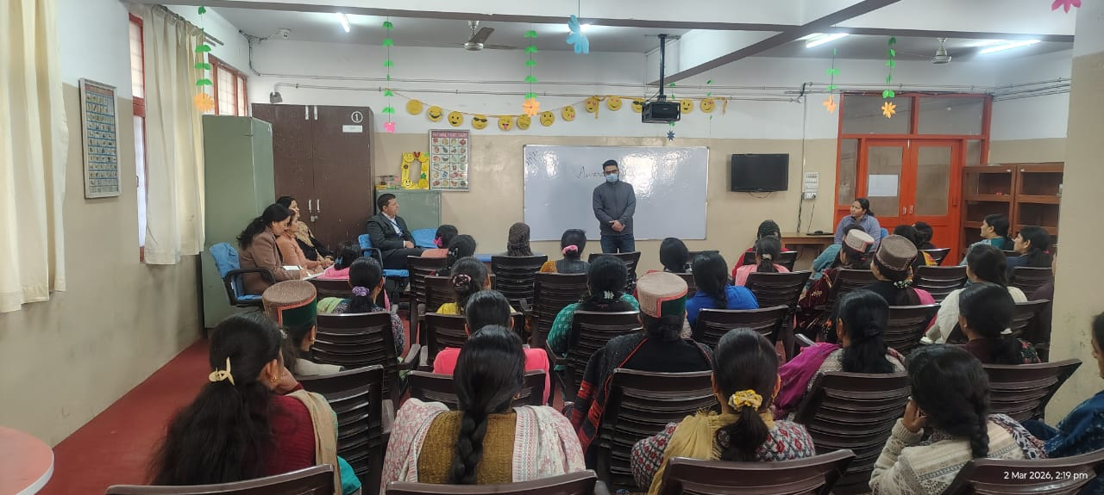
HPV Awareness Session
An informative awareness session on HPV vaccination was conducted by Dr. Mayank (PHC Tapri) and his team. This initiative is part of the Central Government’s HPV Vaccination Drive Dr. Mayank uprised parents about The HPV vaccine that protects against Human Papillomavirus, a leading cause of cervical cancer and other health issues. It is safe, effective, and available free of cost under this government initiative.

Slide 22
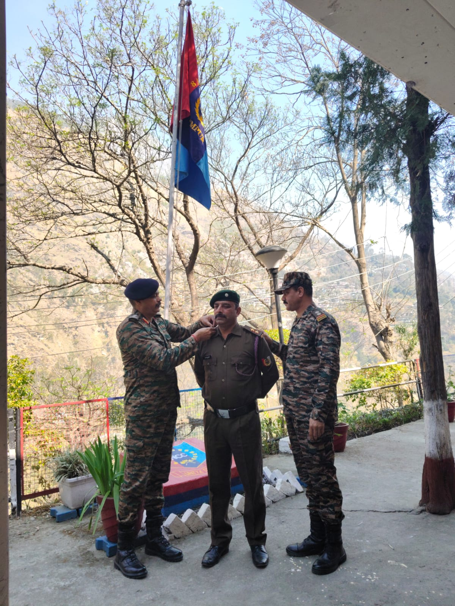
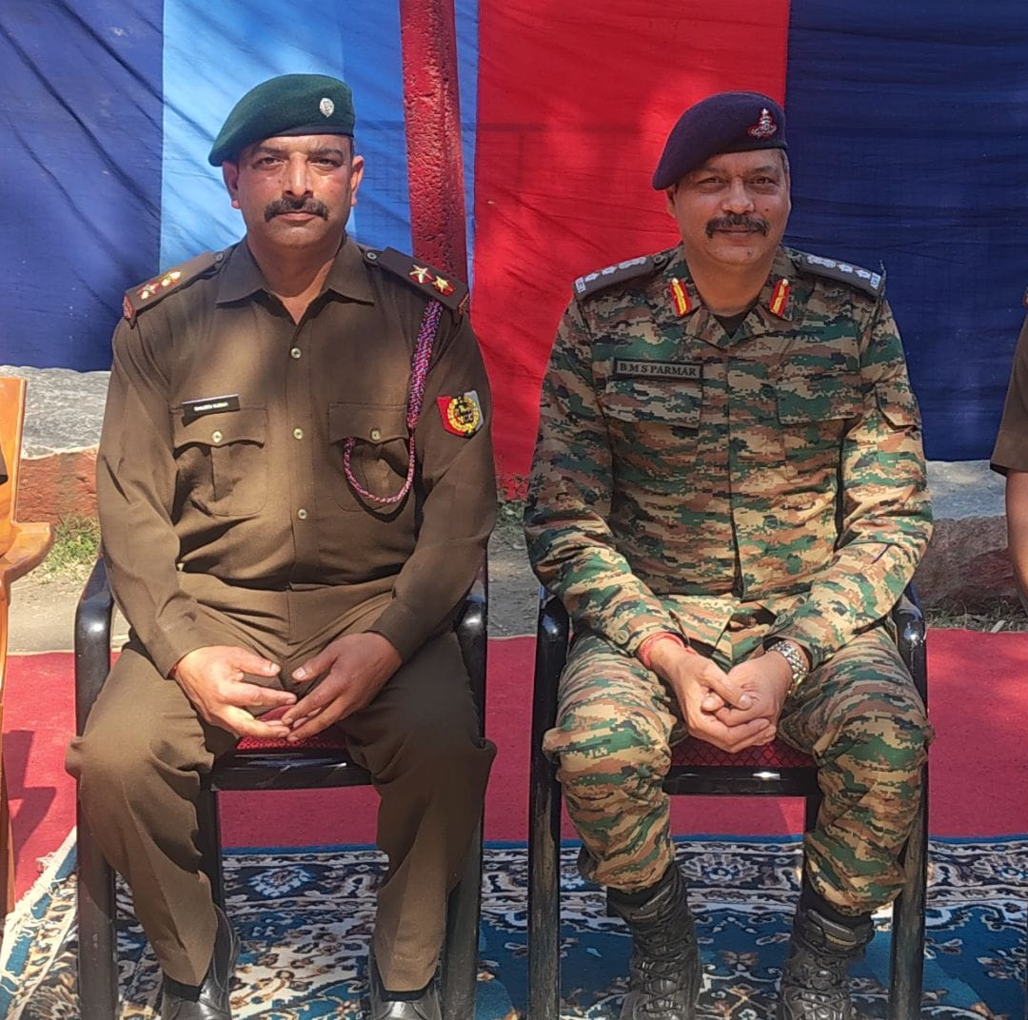
Heartfelt Congratulations, Sir!
Dear Sanjeev Sir, Warmest congratulations on your appointment as Second Officer (ANO) in NCC! Your tireless efforts, unwavering commitment, and exceptional leadership have not only earned you this prestigious role but also inspired countless students. We are incredibly proud of your achievements and the values you instill in our school community. Best wishes for continued success!

Slide 23
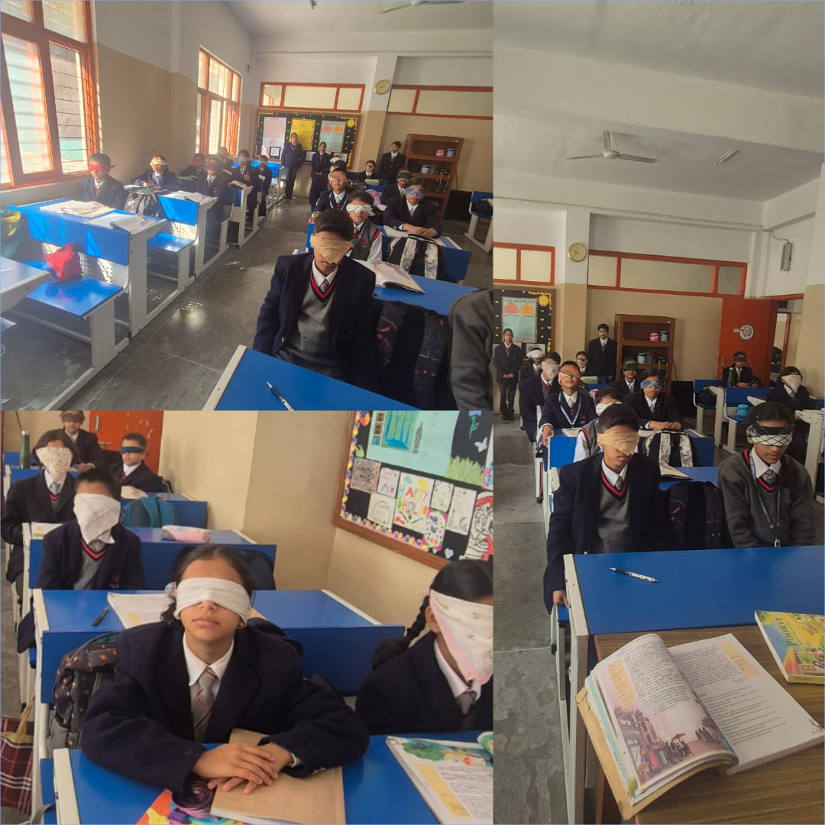
English Activity
“An empathy-driven learning activity designed to help students explore and understand the emotional and sensory experiences of individuals with visual impairment, inspired by the life of Helen Keller.”

Slide 24
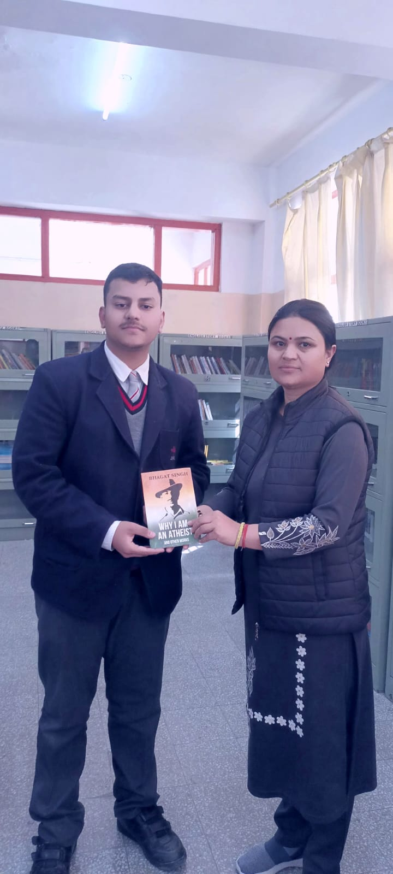
“Books as the Best Gift: A Student’s Initiative”
Class XII student Prateek made his birthday memorable by donating a thoughtful book to the school library. The book, Why I Am an Atheist, is a powerful essay by the great freedom fighter Bhagat Singh. It reflects deep ideas about belief, courage, and rational thinking.
Prateek’s generous contribution not only enriches the library but also inspires fellow students to explore meaningful literature. His act promotes the values of sharing knowledge and developing critical thinking among young minds.

Slide 25
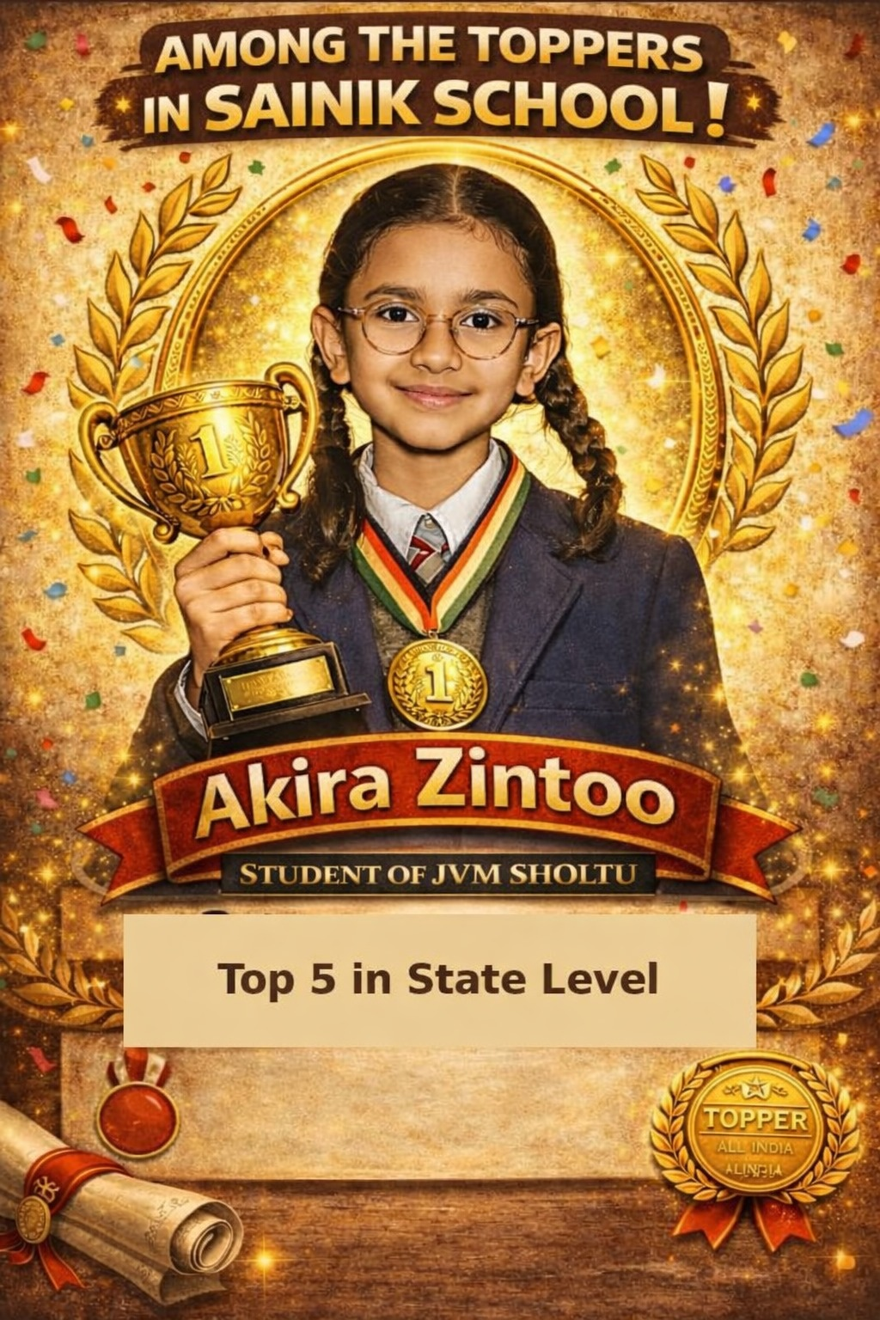
“Among the Best: Akira Zintoo Shines in Sainik School”
Akira Zintoo, a dedicated student of JVM Sholtu, has brought great pride to the institution by securing a position among the toppers in Sainik School. With an outstanding performance, Akira has also achieved a place in the Top 5 at the state level. This remarkable achievement reflects hard work, discipline, and a strong commitment to excellence. The school congratulates Akira on this success and wishes for many more accomplishments in the future.

Slide 26


Monthly Class Soft Board
Best Class Among Classes VI to XII is (Class VII)
Best Classes Among I to V is ( Class 1st)

Slide 27




“Creative Corner”

Slide 28



“Creative Corner”

Slide 29


Ram Navami-Jai Siya Ram
On the occasion of Ram Navami, Class VIII students presented a special assembly showcasing the life and values of Lord Rama. The program included a brief introduction followed by a drama depicting Rama’s exile, Sita’s abduction, and the victory over Ravana.
The highlight was the powerful battle scene symbolizing the triumph of good over evil. With expressive performances and vibrant presentation, the students impressed the audience with their confidence and teamwork.
The assembly concluded with a message to follow truth and righteousness, making it a meaningful and memorable event.

Slide 30



Monthly Review Meeting – Mathematics, Science & SST
Monthly Departmental Meeting (Mathematics, Science, SST) was conducted successfully. Key academic progress was reviewed, subject-wise performance was discussed, and effective teaching strategies were shared. Action plans were formulated to enhance student learning outcomes and ensure continuous improvement in all departments. Challenges faced by students were identified, and suitable remedial measures were planned. Innovative teaching methods, use of technology, and assessment techniques were also discussed to make learning more engaging and effective.

Slide 31



STUDENTS EDITORIAL BOARD
Sameer Negi XII
Pragati Negi XII
Page 29 of 31

Slide 32




TEACHER’S EDITORIAL BOARD
Write Up
Ms. Amita Negi
Coordinator
Ms. Dineshwari Negi
Editing & Designing
Mr. Himmat Negi
Page 30 of 31

Slide 33



Page 31 of 31

